Slide 1
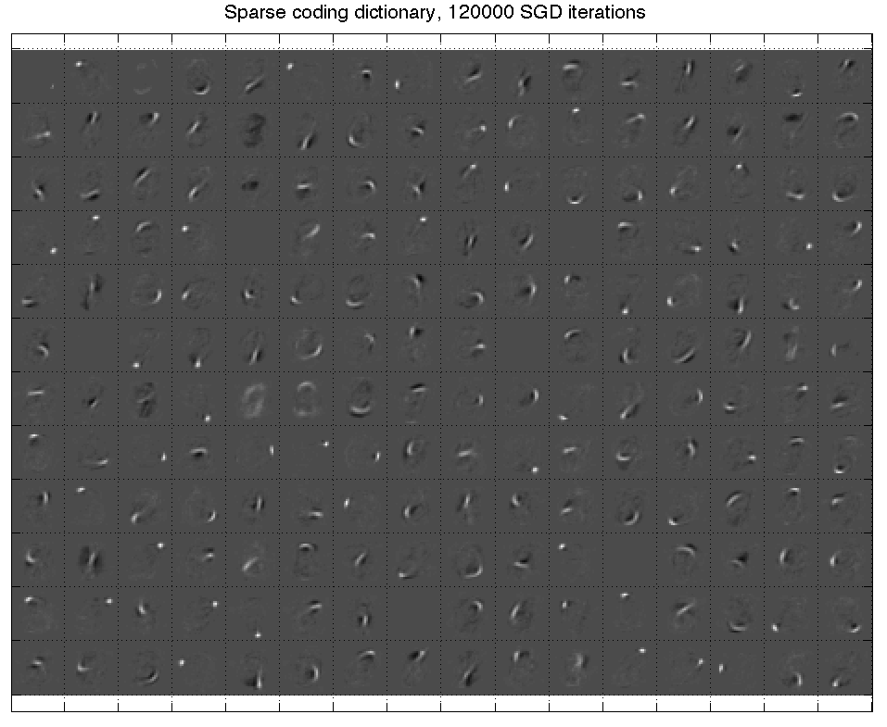


Review of auto-encoders
Sparsity
constraint
Code
Code energy
Input decoding
Code prediction
Decoding energy
Input
Piotr Mirowski, Microsoft Bing London
(Dirk Gorissen)
Computational Intelligence Unconference, 26 July 2014

Slide 2
Outline
Deep learning concepts covered
  Hierarchical representations
  Sparse and/or distributed representations
  Supervised vs. unsupervised learning
Auto-encoder
  Architecture
  Inference and learning
  Sparse coding
  Sparse auto-encoders
Illustration: handwritten digits
  Stacking auto-encoders
  Learning representations of digits
  Impact on classification
Applications to text
  Semantic hashing
  Semi-supervised learning
  Moving away from auto-encoders
Topics not covered in this talk

Slide 3
Outline
Deep learning concepts covered
  Hierarchical representations
  Sparse and/or distributed representations
  Supervised vs. unsupervised learning
Auto-encoder
  Architecture
  Inference and learning
  Sparse coding
  Sparse auto-encoders
Illustration: handwritten digits
  Stacking auto-encoders
  Learning representations of digits
  Impact on classification
Applications to text
  Semantic hashing
  Semi-supervised learning
  Moving away from auto-encoders
Topics not covered in this talk

Slide 4
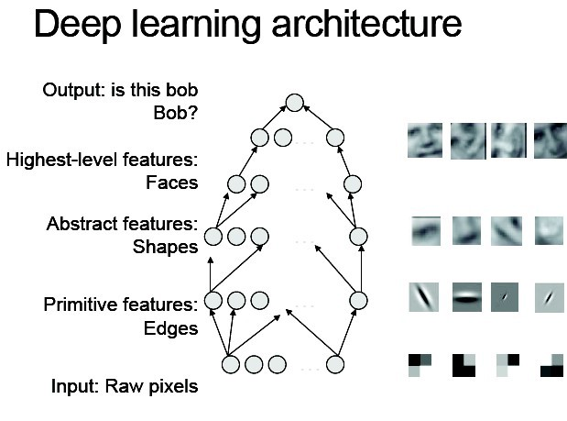
Hierarchical representations
“Deep learning methods aim at
learning feature hierarchies
with features from higher levels
of the hierarchy formed by the
composition of lower level features.
Automatically learning features
at multiple levels of abstraction
allows a system
to learn complex functions mapping the input to the output directly from data,
without depending completely
on human-crafted features.”
— Yoshua Bengio
[Bengio, “On the expressive power of deep architectures”, Talk at ALT, 2011]
[Bengio, Learning Deep Architectures for AI, 2009]

Slide 5
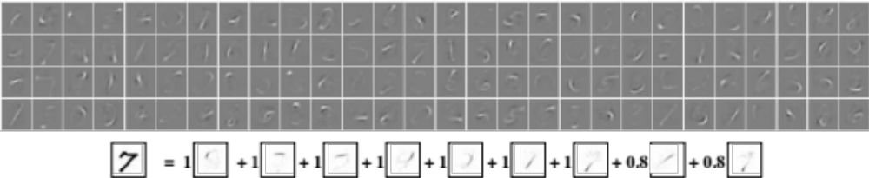
Sparse and/or distributed representations
Biological motivation: V1 visual cortex
Example on MNIST handwritten digits
An image of size 28x28 pixels can be represented
using a small combination of codes from a basis set.
[Ranzato, Poultney, Chopra & LeCun, “Efficient Learning of Sparse Representations with an Energy-Based Model ”, NIPS, 2006;
Ranzato, Boureau & LeCun, “Sparse Feature Learning for Deep Belief Networks ”, NIPS, 2007]

Slide 6
Sparse and/or distributed representations
Biological motivation: V1 visual cortex (backup slides)
Example on MNIST handwritten digits
An image of size 28x28 pixels can be represented
using a small combination of codes from a basis set.
At the end of this talk, you should know how to learn that basis set
and how to infer the codes, in a 2-layer auto-encoder architecture.
Matlab/Octave code and the MNIST dataset will be provided.
[Ranzato, Poultney, Chopra & LeCun, “Efficient Learning of Sparse Representations with an Energy-Based Model ”, NIPS, 2006;
Ranzato, Boureau & LeCun, “Sparse Feature Learning for Deep Belief Networks ”, NIPS, 2007]

Slide 7

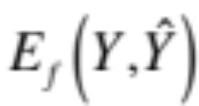
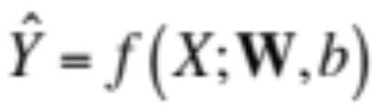
Supervised learning
Target
Error
Prediction
Input

Slide 8
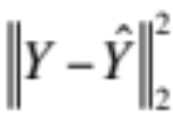

Supervised learning
Target
Error
Prediction
Input

Slide 9
Why not exploit unlabeled data?

Slide 10

Unsupervised learning
No target…
No error…
Prediction
Input

Slide 11
Unsupervised learning
Code
“latent/hidden”
representation
Error(s)
Prediction(s)
Input

Slide 12
Unsupervised learning
We want
the codes
to represent
the inputs
in the dataset.
Code
Error(s)
The code should
be a compact
representation
of the inputs:
low-dimensional
and/or sparse.
Prediction(s)
Input

Slide 13
Examples of unsupervised learning
Linear decomposition of the inputs:
  Principal Component Analysis and Singular Value Decomposition
  Independent Component Analysis [Bell & Sejnowski, 1995]
  Sparse coding [Olshausen & Field, 1997]
  …
Fitting a distribution to the inputs:
  Mixtures of Gaussians
  Use of Expectation-Maximization algorithm [Dempster et al, 1977]
  …
For text or discrete data:
  Latent Semantic Indexing [Deerwester et al, 1990]
  Probabilistic Latent Semantic Indexing [Hofmann et al, 1999]
  Latent Dirichlet Allocation [Blei et al, 2003]
  Semantic Hashing
  …

Slide 14
Objective of this tutorial
Study a fundamental building block
for deep learning,
the auto-encoder

Slide 15
Outline
Deep learning concepts covered
  Hierarchical representations
  Sparse and/or distributed representations
  Supervised vs. unsupervised learning
Auto-encoder
  Architecture
  Inference and learning
  Sparse coding
  Sparse auto-encoders
Illustration: handwritten digits
  Stacking auto-encoders
  Learning representations of digits
  Impact on classification
Applications to text
  Semantic hashing
  Semi-supervised learning
  Moving away from auto-encoders
Topics not covered in this talk

Slide 16

Auto-encoder
Target
= input
Target
= input
Code
Code
Input
Input
“Bottleneck” code
i.e., low-dimensional,
typically dense,
distributed
representation
“Overcomplete” code
i.e., high-dimensional,
always sparse,
distributed
representation

Slide 17
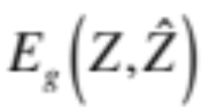
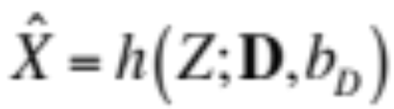
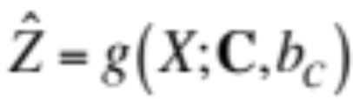
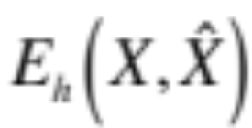
Auto-encoder
Code
Encoding
“energy”
Input
decoding
Code
prediction
Decoding
“energy”
Input

Slide 18
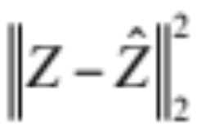
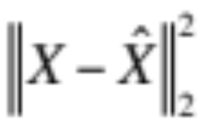
Auto-encoder
Code
Encoding
energy
Input
decoding
Code
prediction
Decoding
energy
Input

Slide 19
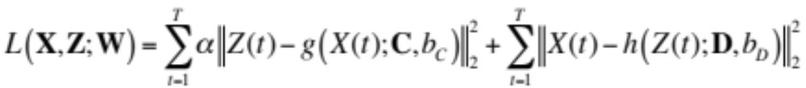
Auto-encoder loss function
For one sample t
Encoding energy
Decoding energy
coefficient of
the encoder error
For all T samples
Encoding energy
Decoding energy
How do we get the codes Z?
We note W={C, b_{C}, D, b_{D}}

Slide 20
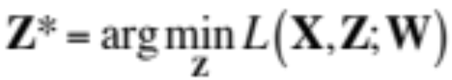
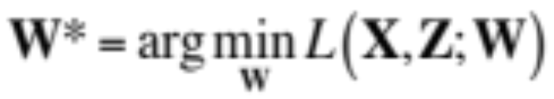
Learning and inference in auto-encoders
Infer the codes Z
given the current
model parameters W
Learn the parameters (weights) W
of the encoder and decoder
given the current codes Z
Relationship to Expectation-Maximization
in graphical models (backup slides)

Slide 21
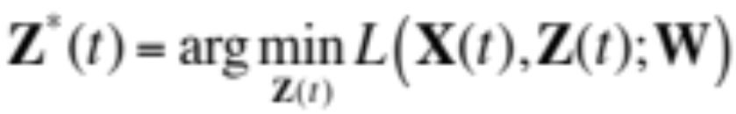
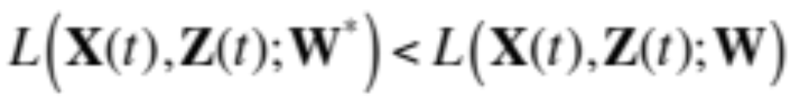
Learning and inference: stochastic gradient descent
Iterated gradient descent (?)
on the code Z(t)
given the current
model parameters W
Take a gradient descent step
on the parameters (weights) W
of the encoder and decoder
given the current codes Z
Relationship to Generalized EM
in graphical models (backup slides)

Slide 22
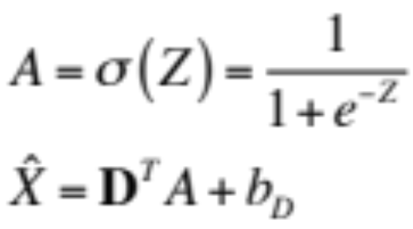
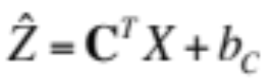
Auto-encoder
Code
Encoding
energy
Input
decoding
Code
prediction
Decoding
energy
Input

Slide 23
Auto-encoder: fprop
Code
function [x_hat, a_hat] = …
Module_Decode_FProp(model, z)
% Apply the logistic to the code
a_hat = 1 ./ (1 + exp(-z));
% Linear decoding
x_hat = model.D * a_hat + model.bias_D;
function e = Loss_Gaussian(z, z_hat)
zDiff = z_hat - z;
e = 0.5 * sum(zDiff.^2);
function z_hat = …
Module_Encode_FProp(model, x, params)
% Compute the linear encoding activation
z_hat = model.C * x + model.bias_C;
function e = Loss_Gaussian(x, x_hat)
xDiff = x_hat - x;
e = 0.5 * sum(xDiff.^2);
Input

Slide 24
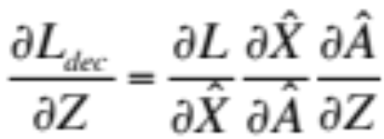
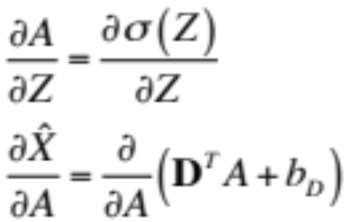
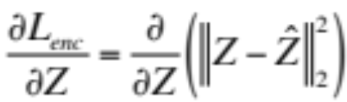
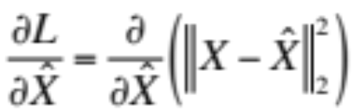
Auto-encoder backprop w.r.t. codes
Code
Encoding
energy
Code
prediction
Input
[Ranzato, Boureau & LeCun, “Sparse Feature Learning for Deep Belief Networks ”, NIPS, 2007]

Slide 25
Auto-encoder: backprop w.r.t. codes
Code
function dL_dz = ...
Module_Decode_BackProp_Codes(model, dL_dx, a_hat)
% Gradient of the loss w.r.t. activations
dL_da = model.D' * dL_dx;
% Gradient of the loss w.r.t. latent codes
% a_hat = 1 ./ (1 + exp(-z_hat))
dL_dz = dL_da .* a_hat .* (1 - a_hat);
% Add the gradient w.r.t.
% the encoder's outputs
dL_dz = z_star - z_hat;
% Gradient of the loss w.r.t.
% the decoder prediction
dL_dx_star = x_star - x;
Input
[Ranzato, Boureau & LeCun, “Sparse Feature Learning for Deep Belief Networks ”, NIPS, 2007]

Slide 26
Code inference in the auto-encoder
function [z_star, z_hat, loss_star, loss_hat] = Layer_Infer(model, x, params)
% Encode the current input and initialize the latent code
z_hat = Module_Encode_FProp(model, x, params);
% Decode the current latent code
[x_hat, a_hat] = Module_Decode_FProp(model, z_hat);
% Compute the current loss term due to decoding (encoding loss is 0)
loss_hat = Loss_Gaussian(x, x_hat);
% Relaxation on the latent code: loop until convergence
x_star = x_hat; a_star = a_hat; z_star = z_hat; loss_star = loss_hat;
while (true)
% Gradient of the loss function w.r.t. decoder prediction
dL_dx_star = x_star - x;
% Back-propagate the gradient of the loss onto the codes
dL_dz = Module_Decode_BackProp_Codes(model, dL_dx_star, a_star, params);
% Add the gradient w.r.t. the encoder's outputs
dL_dz = dL_dz + params.alpha_c * (z_star - z_hat);
% Perform one step of gradient descent on the codes
z_star = z_star - params.eta_z * dL_dz;
% Decode the current latent code
[x_star, a_star] = Module_Decode_FProp(model, z_star);
% Compute the current loss and convergence criteria
loss_star = Loss_Gaussian(x, x_star) + ...
params.alpha_c * Loss_Gaussian(z_star, z_hat);
% Stopping criteria
[...]
end
Code
Encoding
energy
Code
prediction
Input
[Ranzato, Boureau & LeCun, “Sparse Feature Learning for Deep Belief Networks ”, NIPS, 2007]

Slide 27
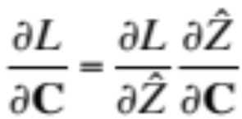
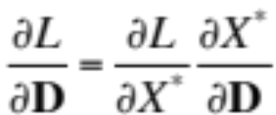

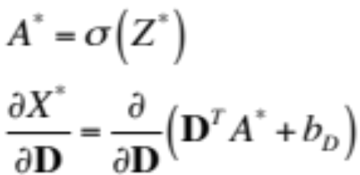
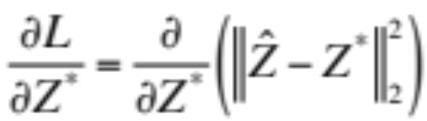
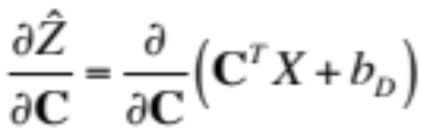
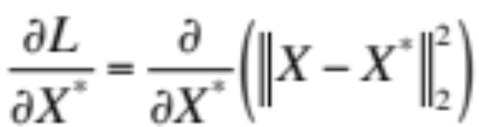
Auto-encoder backprop w.r.t. codes
Code
Encoding
energy
Code
prediction
Input
[Ranzato, Boureau & LeCun, “Sparse Feature Learning for Deep Belief Networks ”, NIPS, 2007]

Slide 28
Auto-encoder: backprop w.r.t. weights
Code
% Gradient of the loss w.r.t. codes
dL_dz = z_hat - z_star;
function model = ...
Module_Decode_BackProp_Weights(model, ...
dL_dx_star, a_star, params)
% Jacobian of the loss w.r.t. decoder matrix
model.dL_dD = dL_dx_star * a_star';
% Gradient of the loss w.r.t. decoder bias
model.dL_dbias_D = dL_dx_star;
function model = ...
Module_Encode_BackProp_Weights(model, ...
dL_dz, x, params)
% Jacobian of the loss w.r.t. encoder matrix
model.dL_dC = dL_dz * x';
% Gradient of the loss w.r.t. encoding bias
model.dL_dbias_C = dL_dz;
% Gradient of the loss w.r.t. reconstruction
dL_dx_star = x_star - x;
Input
[Ranzato, Boureau & LeCun, “Sparse Feature Learning for Deep Belief Networks ”, NIPS, 2007]

Slide 29
Usual tricks about classical SGD
Regularization (L1-norm or L2-norm)
of the parameters?
Learning rate?
Learning rate decay?
Momentum term on the parameters?
Choice of the learning hyperparameters
  Cross-validation?

Slide 30
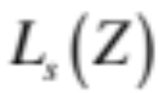
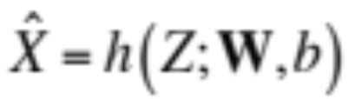
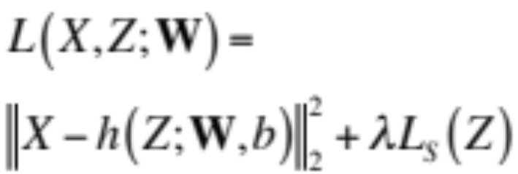
Sparse coding
Sparsity constraint
Overcomplete code
Input
decoding
Decoding
error
Input
[Olshausen & Field, “Sparse coding with an overcomplete basis set: a strategy employed by V1? ”, Vision Research, 1997]

Slide 31
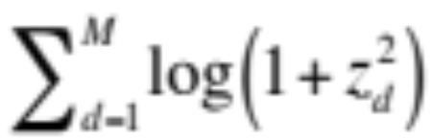
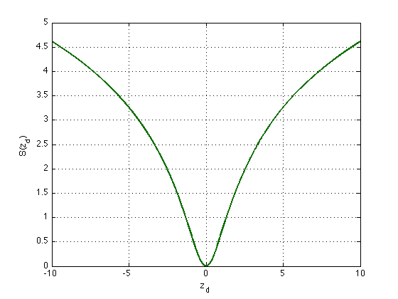
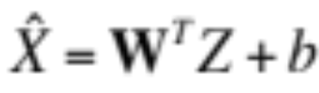
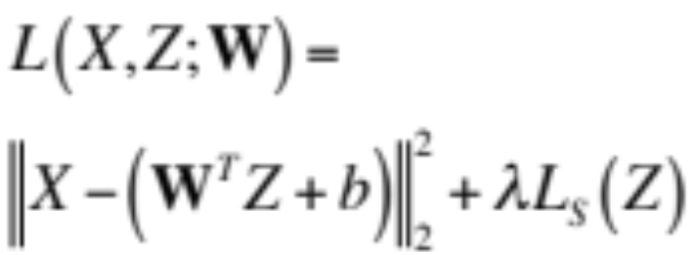
Sparse coding
Sparsity constraint
Overcomplete code
Input
decoding
Decoding
error
Input
[Olshausen & Field, “Sparse coding with an overcomplete basis set: a strategy employed by V1? ”, Vision Research, 1997]

Slide 32

Limitations of sparse coding
At runtime, assuming a trained model W,
inferring the code Z given an input sample X
is expensive
Need a tweak on the model weights W:
normalize the columns of W to unit length
after each learning step
Otherwise:
code pulled to 0
by sparsity constraint
weights go to
infinity to compensate

Slide 33
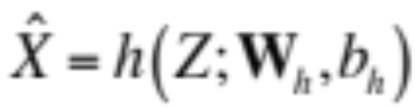
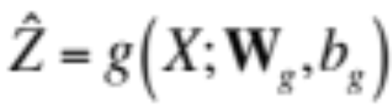
Sparse auto-encoder
Sparsity constraint
Code
Code
error
Input
decoding
Code
prediction
Decoding
error
Input
[Ranzato, Poultney, Chopra & LeCun, “Efficient Learning of Sparse Representations with an Energy-Based Model ”, NIPS, 2006;
Ranzato, Boureau & LeCun, “Sparse Feature Learning for Deep Belief Networks ”, NIPS, 2007]

Slide 34
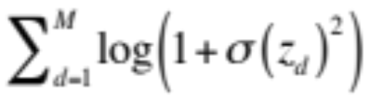
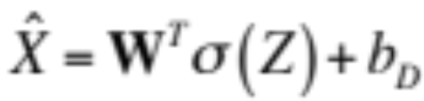
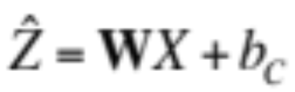
Symmetric sparse auto-encoder
Sparsity constraint
Code
Encoder matrix W
is symmetric to
decoder matrix W^{T}
Code
error
Input
decoding
Code
prediction
Decoding
error
Input
[Ranzato, Poultney, Chopra & LeCun, “Efficient Learning of Sparse Representations with an Energy-Based Model ”, NIPS, 2006;
Ranzato, Boureau & LeCun, “Sparse Feature Learning for Deep Belief Networks ”, NIPS, 2007]

Slide 35
Predictive Sparse Decomposition
Code
Once the encoder g
is properly trained,
the code Z can be
directly predicted
from input X
Code
prediction
Input

Slide 36
Outline
Deep learning concepts covered
  Hierarchical representations
  Sparse and/or distributed representations
  Supervised vs. unsupervised learning
Auto-encoder
  Architecture
  Inference and learning
  Sparse coding
  Sparse auto-encoders
Illustration: handwritten digits
  Stacking auto-encoders
  Learning representations of digits
  Impact on classification
Applications to text
  Semantic hashing
  Semi-supervised learning
  Moving away from auto-encoders
Topics not covered in this talk

Slide 37
Stacking auto-encoders
Code
Sparsity
constraint
Code energy
Input decoding
Code prediction
Decoding energy
[Ranzato, Boureau & LeCun, “Sparse Feature Learning for Deep Belief Networks ”, NIPS, 2007]
Input
Sparsity
constraint
Code
Code energy
Input decoding
Code prediction
Decoding energy
Input

Slide 38

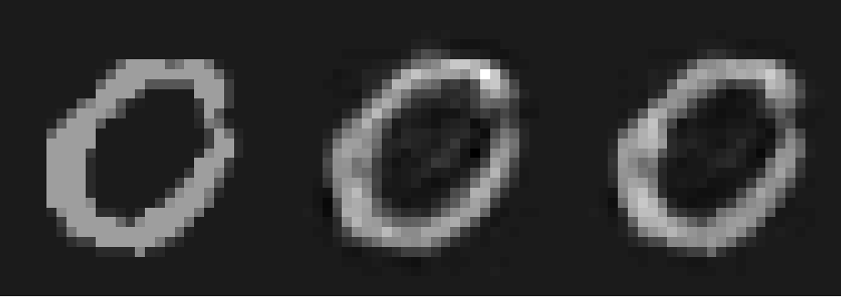
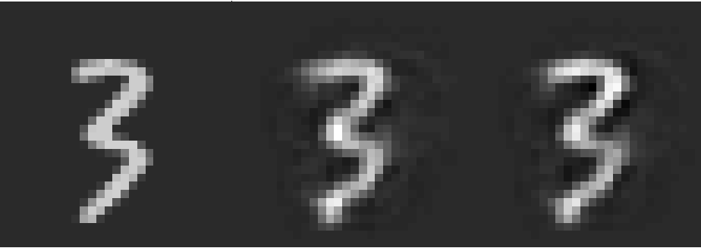
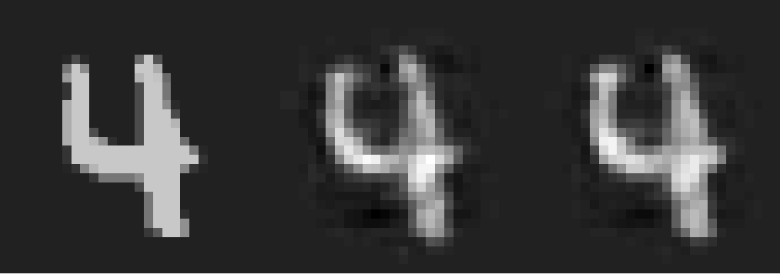
MNIST handwritten digits
Database of 70k
handwritten digits
  Training set: 60k
  Test set: 10k
28 x 28 pixels
Best performing classifiers:
  Linear classifier: 12% error
  Gaussian SVM 1.4% error
  ConvNets <1% error
[http://yann.lecun.com/exdb/mnist/]

Slide 39

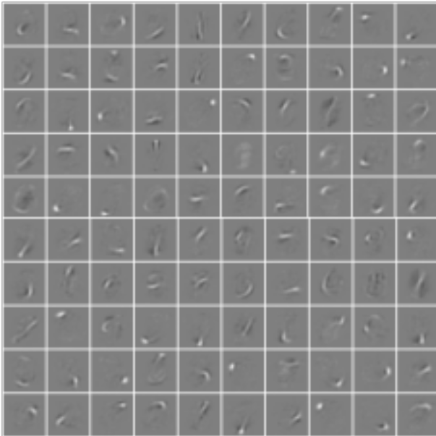
Stacked auto-encoders
Code
Sparsity
constraint
Layer 2: Matrix W₂ of size 10 x 192
10 sparse bases of 192 units
Code energy
Input decoding
Code prediction
Decoding energy
Layer 1: Matrix W₁ of size 192 x 784
192 sparse bases of 28 x 28 pixels
[Ranzato, Boureau & LeCun, “Sparse Feature Learning for Deep Belief Networks ”, NIPS, 2007]
Input
Sparsity
constraint
Code
Code energy
Input decoding
Code prediction
Decoding energy
Input

Slide 40
Our results: bases learned on layer 1

Slide 41
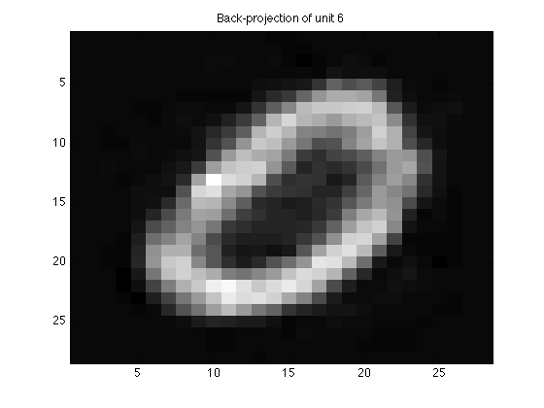
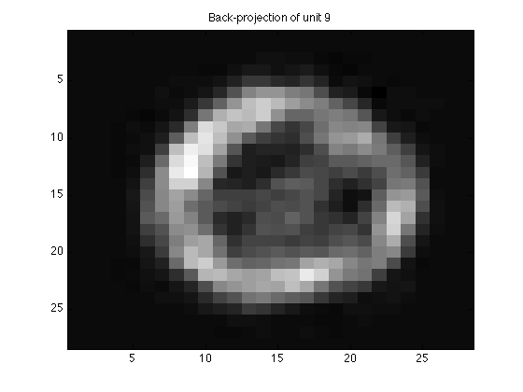
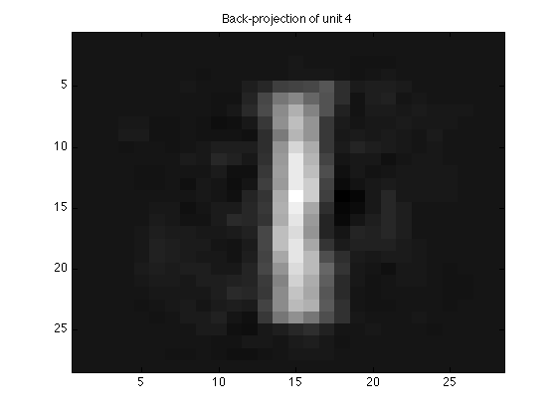
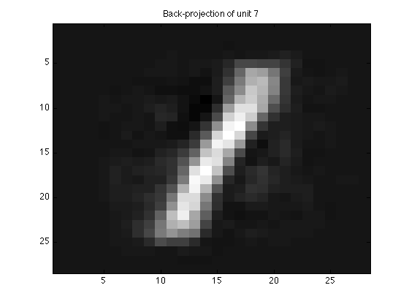
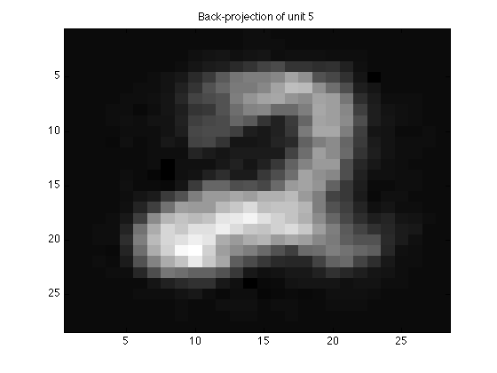





Our results: back-projecting layer 2

Slide 42

Sparse representations
Layer 1
Layer 2

Slide 43


Training “converges” in one pass over data
Layer 1
Layer 2

Slide 44
Outline
Deep learning concepts covered
  Hierarchical representations
  Sparse and/or distributed representations
  Supervised vs. unsupervised learning
Auto-encoder
  Architecture
  Inference and learning
  Sparse coding
  Sparse auto-encoders
Illustration: handwritten digits
  Stacking auto-encoders
  Learning representations of digits
  Impact on classification
Applications to text
  Semantic hashing
  Semi-supervised learning
  Moving away from auto-encoders
Topics not covered in this talk

Slide 45

Semantic Hashing
2000
500
250
125
2
125
250
500
2000
[Hinton & Salakhutdinov, “Reducing the dimensionality of data with neural networks, Science, 2006;
Salakhutdinov & Hinton, “Semantic Hashing”, Int J Approx Reason, 2007]

Slide 46

Semi-supervised learning of auto-encoders
Add classifier module to the codes
When a input X(t) has a label Y(t),
back-propagate the prediction error on Y(t)
to the code Z(t)
Stack the encoders
Train layer-wise
y(t)
y(t+1)
document
classifier f3
z⁽³⁾(t)
z⁽³⁾(t+1)
y(t)
y(t+1)
auto-encoder g3,h3
document
classifier f2
z⁽²⁾(t)
z⁽²⁾(t+1)
y(t)
y(t+1)
auto-encoder g2,h2
document
classifier f1
z⁽¹⁾(t)
z⁽¹⁾(t+1)
Random
walk
auto-encoder g1,h1
word histograms
x(t)
x(t+1)
[Ranzato & Szummer, “Semi-supervised learning of compact document representations with deep networks”, ICML, 2008;
Mirowski, Ranzato & LeCun, “Dynamic auto-encoders for semantic indexing”, NIPS Deep Learning Workshop, 2010]

Slide 47


Semi-supervised learning of auto-encoders
Performance on document retrieval task:
Reuters-21k dataset (9.6k training, 4k test),
vocabulary 2k words, 10-class classification
Comparison with:
unsupervised techniques
(DBN: Semantic Hashing, LSA) + SVM
traditional technique: word TF-IDF + SVM
[Ranzato & Szummer, “Semi-supervised learning of compact document representations with deep networks”, ICML, 2008;
Mirowski, Ranzato & LeCun, “Dynamic auto-encoders for semantic indexing”, NIPS Deep Learning Workshop, 2010]

Slide 48
Beyond auto-encoders for web search (MSR)
Compute Cosine similarity
between semantic vectors
cos(s,t1)
cos(s,t2)
Semantic vector
d=300
d=300
d=300
W₄
d=500
d=500
d=500
W₃
Letter-tri-gram embedding matrix
d=500
d=500
d=500
W₂
Letter-tri-gram coeff.
matrix (fixed)
dim = 50K
dim = 50K
dim = 50K
W₁
Bag-of-words vector
dim = 5M
dim = 5M
dim = 5M
Input word/phrase
s: “racing car”
t1: “formula one”
t2: “ford model t”
[Huang, He, Gao, Deng et al, “Learning Deep Structured Semantic Models for Web Search using Clickthrough Data”, CIKM, 2013]

Slide 49

Beyond auto-encoders for web search (MSR)
Results on a web ranking task (16k queries)
Normalized discounted cumulative gains
Semantic hashing
[Salakhutdinov & Hinton, 2007]
Deep Structured
Semantic Model
[Huang, He, Gao et al, 2013]
[Huang, He, Gao, Deng et al, “Learning Deep Structured Semantic Models for Web Search using Clickthrough Data”, CIKM, 2013]

Slide 50
Outline
Deep learning concepts covered
  Hierarchical representations
  Sparse and/or distributed representations
  Supervised vs. unsupervised learning
Auto-encoder
  Architecture
  Inference and learning
  Sparse coding
  Sparse auto-encoders
Illustration: handwritten digits
  Stacking auto-encoders
  Learning representations of digits
  Impact on classification
Applications to text
  Semantic hashing
  Semi-supervised learning
  Moving away from auto-encoders
Topics not covered in this talk

Slide 51



Topics not covered in this talk
Other variations of auto-encoders
  Restricted Boltzmann Machines (work in Geoff Hinton’s lab)
  Denoising Auto-Encoders
  (work in Yoshua Bengio’s lab)
Invariance to shifts in
input and feature space
  Convolutional kernels
  Sliding windows over input
  Max-pooling over codes
[LeCun, Bottou, Bengio & Haffner, “Gradient-based learning applied to document recognition”, Proceedings of IEEE,1998;
Le, Ranzato et al. "Building high-level features using large-scale unsupervised learning" ICML 2012;
Sermanet et al, “OverFeat: Integrated Recognition, Localization and Detection using Convolutional Networks”, ICLR 2014]

Slide 52
Thank you!
Tutorial code:
https://github.com/piotrmirowski
http://piotrmirowski.wordpress.com
Contact:
piotr.mirowski@computer.org
Acknowledgements:
Marc’Aurelio Ranzato (FB)
Yann LeCun (FB/NYU)

Slide 53




Auto-encoders and Expectation-Maximization
Energy of inputs and codes
Input data likelihood
Do not marginalize over:
take maximum likelihood
latent code instead
Maximum A Posteriori: take minimal energy code Z
Enforce sparsity on Z
to constrain Z and
avoid computing
partition function

Slide 54

Stochastic gradient descent
[LeCun et al, "Efficient BackProp", Neural Networks: Tricks of the Trade, 1998;
Bottou, "Stochastic Learning", Slides from a talk in Tubingen, 2003]

Slide 55

Stochastic gradient descent
[LeCun et al, "Efficient BackProp", Neural Networks: Tricks of the Trade, 1998;
Bottou, "Stochastic Learning", Slides from a talk in Tubingen, 2003]

Slide 56









Dimensionality reduction and invariant mapping
Similarly
labelled
samples
Dissimilar
codes
[Hadsell, Chopra & LeCun, “Dimensionality Reduction by Learning an Invariant Mapping”, CVPR, 2006]

