Slide 1
Tutorial on neural probabilistic language models
Piotr Mirowski, Microsoft Bing London
South England NLP Meetup @ UCL
April 30, 2014

Slide 2
Ackowledgements
AT&T Labs Research
  Srinivas Bangalore
  Suhrid Balakrishnan
  Sumit Chopra (now at Facebook)
New York University
  Yann LeCun (now at Facebook)
Microsoft
  Abhishek Arun

Slide 3
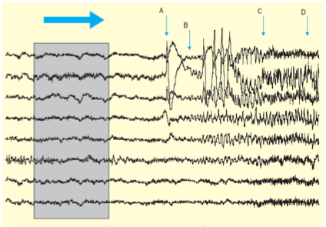
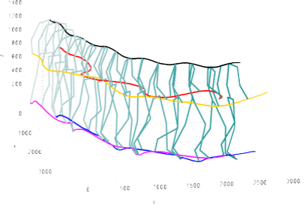
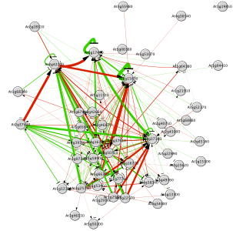
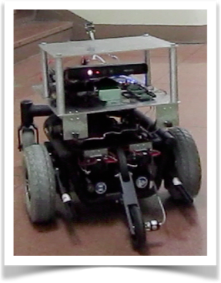
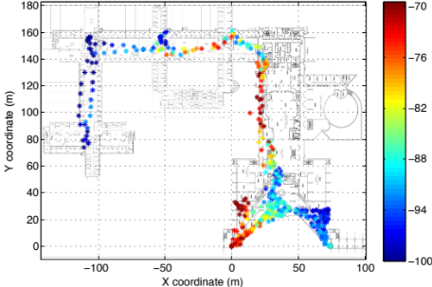

About the presenter
NYU (2005-2010)
  Deep learning for time series
    Epileptic seizure prediction
    Gene regulation networks
    Text categorization of online news
    Statistical language models
Bell Labs (2011-2013)
  WiFi-based indoor geolocation
  SLAM and robotics
  Load forecasting in smart grids
Microsoft Bing (2013-)
  AutoSuggest (Query Formulation)

Slide 4
Objective of this tutorial
Understand deep learning approaches
to distributional semantics:
word embeddings and continuous space language models

Slide 5
Outline
Probabilistic Language Models (LMs)
  Likelihood of a sentence and LM perplexity
  Limitations of n-grams
Neural Probabilistic LMs
  Vector-space representation of words
  Neural probabilistic language model
  Log-Bilinear (LBL) LMs (loss function maximization)
Long-range dependencies
  Enhancing LBL with linguistic features
  Recurrent Neural Networks (RNN)
Applications
  Speech recognition and machine translation
  Sentence completion and linguistic regularities
Bag-of-word-vector approaches
  Auto-encoders for text
  Continuous bag-of-words and skip-gram models
Scalability with large vocabularies
  Tree-structured LMs
  Noise-contrastive estimation

Slide 6
Outline
Probabilistic Language Models (LMs)
  Likelihood of a sentence and LM perplexity
  Limitations of n-grams
Neural Probabilistic LMs
  Vector-space representation of words
  Neural probabilistic language model
  Log-Bilinear (LBL) LMs
Long-range dependencies
  Enhancing LBL with linguistic features
  Recurrent Neural Networks (RNN)
Applications
  Speech recognition and machine translation
  Sentence completion and linguistic regularities
Bag-of-word-vector approaches
  Auto-encoders for text
  Continuous bag-of-words and skip-gram models
Scalability with large vocabularies
  Tree-structured LMs
  Noise-contrastive estimation

Slide 7


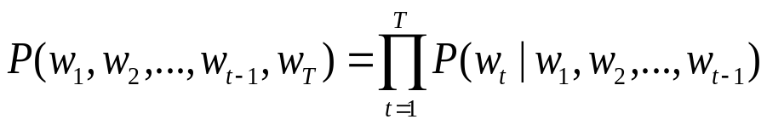
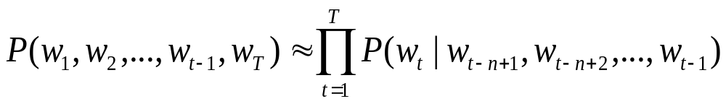
Probabilistic
Language Models
Probability of a sequence of words:
Conditional probability of an upcoming word:
Chain rule of probability:
(n-1)^{th} order Markov assumption

Slide 8
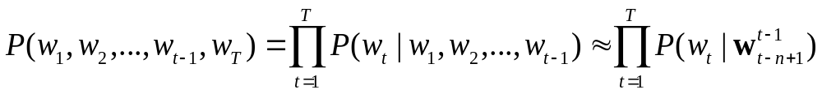


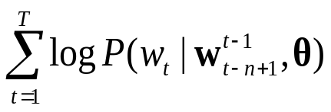
Learning probabilistic language models
Learn joint likelihood of training sentences
under (n-1)^{th} order Markov assumption
using n-grams
Maximize the log-likelihood:
  Assuming a parametric model θ
Could we take advantage of higher-order history?
target word
word history

Slide 9
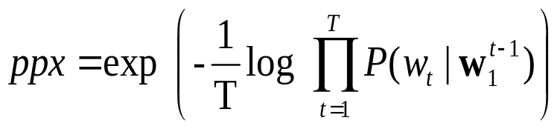
Evaluating language models: perplexity
How well can we predict next word?
  A random predictor would give each word probability 1/V
  where V is the size of the vocabulary
  A better model of a text should assign a higher probability
  to the word that actually occurs
Perplexity:
mushrooms 0.1
pepperoni 0.1
anchovies 0.01
….
fried rice 0.0001
….
and 1e-100
I always order pizza with cheese and ____
The 33rd President of the US was ____
I saw a ____

Slide 10










Limitations of n-grams
Conditional likelihood of seeing
a sub-sequence of length n
in available training data
Limitation: discrete model (each word is a token)
  Incomplete coverage of the training dataset
  Vocabulary of size V words: V^{n} possible n-grams (exponential in n)
  Semantic similarity between word tokens is not exploited
the
cat
sat
on
the
mat
the
cat
sat
on
the
hat
the
cat
sat
on
the
sat
my
cat
sat
on
the
mat
the
cat
sat
on
the
rug

Slide 11
Workarounds for n-grams
Smoothing
  Adding non-zero offset to probabilities of unseen words
  Example: Kneyser-Ney smoothing
Back-off
  No such trigram? try bigrams…
  No such bigram? try unigrams…
Interpolation
  Mix unigram, bigram, trigram, etc…

Slide 12
Outline
Probabilistic Language Models (LMs)
  Likelihood of a sentence and LM perplexity
  Limitations of n-grams
Neural Probabilistic LMs
  Vector-space representation of words
  Neural probabilistic language model
  Log-Bilinear (LBL) LMs
Long-range dependencies
  Enhancing LBL with linguistic features
  Recurrent Neural Networks (RNN)
Applications
  Speech recognition and machine translation
  Sentence completion and linguistic regularities
Bag-of-word-vector approaches
  Auto-encoders for text
  Continuous bag-of-words and skip-gram models
Scalability with large vocabularies
  Tree-structured LMs
  Noise-contrastive estimation

Slide 13
Continuous Space Language Models
Word tokens mapped
to vectors in a low-dimensional space
Conditional word probabilities replaced by
normalized dynamical models
on vectors of word embeddings
Vector-space representation enables semantic/syntactic similarity between words/sentences
  Use cosine similarity as semantic word similarity
  Find nearest neighbours: synonyms, antonyms
  Algebra on words: {king} – {man} + {woman} = {queen}?

Slide 14




Vector-space representation of words
“One-hot” of “one-of-V”
representation
of a word token at position t
in the text corpus,
with vocabulary of size V
1
Vector-space representation
of the prediction
of target word w_{t}
(we predict a vector of size D)
ẑ_{t}
v
V
z_{t-1}
Vector-space representation
of any word v
in the vocabulary
using a vector of dimension D
Also called
distributed representation
z_{v}
1
Vector-space representation
of the t^{th} word history:
e.g., concatenation
of n-1 vectors of size D
z_{t-2}
D
z_{t-1}

Slide 15
Learning continuous space language models
Input:
  word history (one-hot or distributed representation)
Output:
  target word (one-hot or distributed representation)
Function that approximates word likelihood:
  Linear transform
  Feed-forward neural network
  Recurrent neural network
  Continuous bag-of-words
  Skip-gram
  …

Slide 16
Learning continuous space language models
How do we learn the word representations z
for each word in the vocabulary?
How do we learn the model that predicts
the next word or its representation ẑ_{t}
given a word history?
Simultaneous learning of model
and representation

Slide 17

Vector-space representation of words
Compare two words using vector representations:
  Dot product
  Cosine similarity
  Euclidean distance
Bi-Linear scoring function at position t:
  Parametric model θ predicts next word
  Bias b_{v} for word v related to unigram probabilities of word v
  Given a predicted vector ẑ_{t},
  the actual predicted word is the 1-nearest neighbour of ẑ_{t}
  Exhaustive search in large vocabularies (V in millions)
  can be computationally expensive…

Slide 18
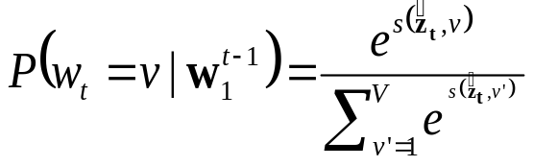
Word probabilities from vector-space representation
Normalized probability:
  Using softmax function
Bi-Linear scoring function at position t:
  Parametric model θ predicts next word
  Bias b_{v} for word v related to unigram probabilities of word v
  Given a predicted vector ẑ_{t},
  the actual predicted word is the 1-nearest neighbour of ẑ_{t}
  Exhaustive search in large vocabularies (V in millions)
  can be computationally expensive…

Slide 19
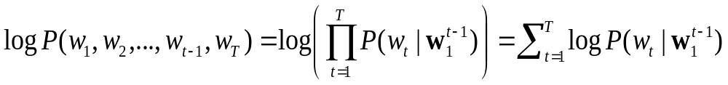
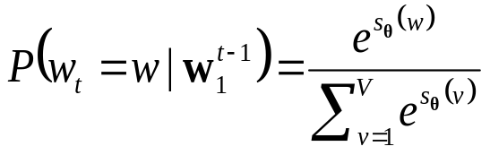
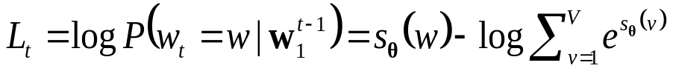
Loss function
Log-likelihood model:
  Numerically more stable
Loss function to maximize:
  Log-likelihood
  In general, loss defined as: score of the right answer + normalization term
  Normalization term is expensive to compute

Slide 20
Neural Probabilistic Language Model
word embedding space ℜ^{D}
z_{t-5}
z_{t-4}
z_{t-3}
z_{t-2}
z_{t-1}
h
A
B
Neural network
100 hidden units
V output units
followed by
softmax
word
embedding
in dimension
D=30
R
R
R
R
R
discrete word space {1, ..., V}
V=18k words
wt-5
wt-4
wt-3
wt-2
wt-1
wt
the
cat
sat
on
the
mat
function z_hist = Embedding_FProp(model, w)
% Get the embeddings for all words in w
z_hist = model.R(:, w);
z_hist = reshape(z_hist, length(w)*model.dim_z, 1);

Slide 21
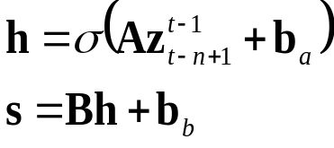
Neural Probabilistic Language Model
function s = NeuralNet_FProp(model, z_hist)
% One hidden layer neural network
o = model.A * z_hist + model.bias_a;
h = tanh(o);
S = model.B * h + model.bias_b;
word embedding space ℜ^{D}
z_{t-5}
z_{t-4}
z_{t-3}
z_{t-2}
z_{t-1}
h
A
B
Neural network
100 hidden units
V output units
followed by
softmax
word
embedding
in dimension
D=30
R
R
R
R
R
discrete word space {1, ..., V}
V=18k words
wt-5
wt-4
wt-3
wt-2
wt-1
wt
the
cat
sat
on
the
mat

Slide 22
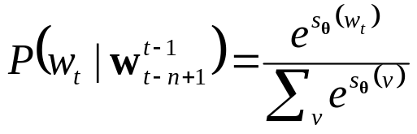
Neural Probabilistic Language Model
word embedding space ℜ^{D}
z_{t-5}
z_{t-4}
z_{t-3}
z_{t-2}
z_{t-1}
h
A
B
Neural network
100 hidden units
V output units
followed by
softmax
word
embedding
in dimension
D=30
function p = Softmax_FProp(s)
% Probability estimation
p_num = exp(s);
p = p_num / sum(p_num);
R
R
R
R
R
discrete word space {1, ..., V}
V=18k words
wt-5
wt-4
wt-3
wt-2
wt-1
wt
the
cat
sat
on
the
mat

Slide 23
Neural Probabilistic Language Model
word embedding space ℜ^{D}
z_{t-5}
z_{t-4}
z_{t-3}
z_{t-2}
z_{t-1}
h
A
B
Neural network
100 hidden units
V output units
followed by
softmax
word
embedding
in dimension
D=30
R
R
R
R
R
discrete word space {1, ..., V}
V=18k words
Outperforms best n-grams
(Class-based Kneyser-Ney
back-off 5-grams) by 7%
wt-5
wt-4
wt-3
wt-2
wt-1
wt
the
cat
sat
on
the
mat
Took months to train
(in 2001-2002) on AP News
corpus (14M words)
Complexity: (n-1)×D + (n-1)×D×H + H×V

Slide 24

Log-Bilinear
Language Model
function z_hat = LBL_FProp(model, z_hist)
% Simple linear transform
Z_hat = model.C * z_hist + model.bias_c;
word embedding space ℜ^{D}
z_{t-5}
z_{t-4}
z_{t-3}
z_{t-2}
z_{t-1}
ẑ_{t}
z_{t}
C
E
Simple matrix
multiplication
word
embedding
in dimension
D=100
R
R
R
R
R
R
discrete word space {1, ..., V}
V=18k words
wt-5
wt-4
wt-3
wt-2
wt-1
wt
the
cat
sat
on
the
mat

Slide 25

Log-Bilinear
Language Model
word embedding space ℜ^{D}
z_{t-5}
z_{t-4}
z_{t-3}
z_{t-2}
z_{t-1}
ẑ_{t}
z_{t}
C
E
Simple matrix
multiplication
function s = ...
Score_FProp(z_hat, model)
s = model.R’ * z_hat + model.bias_v;
word
embedding
in dimension
D=100
R
R
R
R
R
R
discrete word space {1, ..., V}
V=18k words
wt-5
wt-4
wt-3
wt-2
wt-1
wt
the
cat
sat
on
the
mat

Slide 26
Log-Bilinear
Language Model
word embedding space ℜ^{D}
z_{t-5}
z_{t-4}
z_{t-3}
z_{t-2}
z_{t-1}
ẑ_{t}
z_{t}
C
E
Simple matrix
multiplication
word
embedding
in dimension
D=100
R
R
R
R
R
R
discrete word space {1, ..., V}
V=18k words
Slightly better than
best n-grams
(Class-based Kneyser-Ney
back-off 5-grams)
wt-5
wt-4
wt-3
wt-2
wt-1
wt
the
cat
sat
on
the
mat
Takes days to train
(in 2007) on AP News
corpus (14 million words)
Complexity: (n-1)×D + (n-1)×D×D + D×V

Slide 27
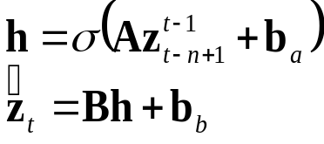
Nonlinear Log-Bilinear
Language Model
word embedding space ℜ^{D}
z_{t-5}
z_{t-4}
z_{t-3}
z_{t-2}
z_{t-1}
h
ẑ_{t}
z_{t}
A
B
E
Neural network
200 hidden units
V output units
followed by
softmax
word
embedding
in dimension
D=100
R
R
R
R
R
R
discrete word space {1, ..., V}
V=18k words
Outperforms best n-grams
(Class-based Kneyser-Ney
back-off 5-grams) by 24%
wt-5
wt-4
wt-3
wt-2
wt-1
wt
the
cat
sat
on
the
mat
Took weeks to train
(in 2009-2010) on AP News
corpus (14M words)
Complexity: (n-1)×D + (n-1)×D×H + H×D + D×V

Slide 28
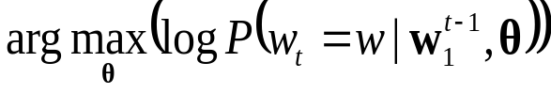
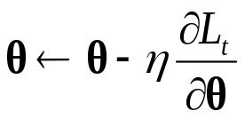
Learning neural language models
Maximize the log-likelihood of observed data,
w.r.t. parameters θ of the neural language model
Parameters θ (in a neural language model):
  Word embedding matrix R and bias b_{v}
  Neural weights: A, b_{A}, B, b_{B}
Gradient descent with learning rate η:

Slide 29
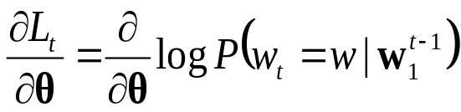
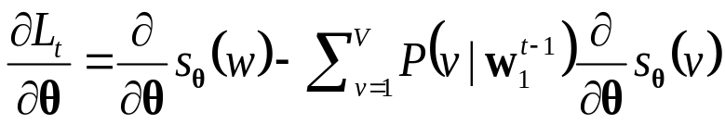
Maximizing the loss function
Maximum Likelihood learning:
  Gradient of log-likelihood w.r.t. parameters θ:
  Use the chain rule of gradients

Slide 30

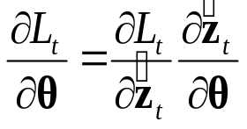
Maximizing the loss function: example of LBL
Maximum Likelihood learning:
  Gradient of log-likelihood w.r.t. parameters θ:
  Neural net: back-propagate gradient
function [dL_dz_hat, dL_dR, dL_dbias_v, w] = ...
Loss_BackProp(z_hat, model, p, w)
% Gradient of loss w.r.t. word bias parameter
dL_dbias_v = -p;
dL_dbias_v(w) = 1 - p;
% Gradient of loss w.r.t. prediction of (N)LBL model
dL_dz_hat = model.R(:, w) – model.R * p;
% Gradient of loss w.r.t. vocabulary matrix R
dL_dR = –z_hat * p’;
dL_dR(:, w) = z_hat * (1 – p(w));
R=(z_{v})
1
D
1
V

Slide 31
Learning neural language models
Randomly choose a mini-batch
(e.g., 1000 consecutive words)
Forward-propagate
through word embeddings
and through model
Estimate word likelihood (loss)
Back-propagate loss
Gradient step to update model

Slide 32
Nonlinear Log-Bilinear
Language Model
z_{t-5}
z_{t-4}
z_{t-3}
z_{t-2}
z_{t-1}
ẑ_{t}
z_{t}
FProp
Look-up embeddings
of the words
in the n-gram using R
Forward propagate
through
the neural net
Look-up ALL vocabulary
words using R
and compute
energy and probabilities
(computationally
expensive)
word embedding space ℜ^{D}
A
h
B
E
Neural network
200 hidden units
V output units
followed by
softmax
word
embedding
in dimension
D=100
R
R
R
R
R
R
discrete word space {1, ..., V}
V=18k words
wt-5
wt-4
wt-3
wt-2
wt-1
wt
the
cat
sat
on
the
mat

Slide 33
Nonlinear Log-Bilinear
Language Model
z_{t-5}
z_{t-4}
z_{t-3}
z_{t-2}
z_{t-1}
ẑ_{t}
z_{t}
BackProp
Compute gradients
of loss w.r.t. output
of the neural net,
back-propagate
through neural net
layers B and A
(computationally
expensive)
Back-propagate
further down to word
embeddings R
Compute gradients
of loss w.r.t. words
of all vocabulary,
back-propagate to R
word embedding space ℜ^{D}
A
h
B
E
Neural network
200 hidden units
V output units
followed by
softmax
word
embedding
in dimension
D=100
R
R
R
R
R
R
discrete word space {1, ..., V}
V=18k words
wt-5
wt-4
wt-3
wt-2
wt-1
wt
the
cat
sat
on
the
mat

Slide 34
Stochastic Gradient Descent (SGD)
Choice of the learning hyperparameters
  Learning rate?
  Learning rate decay?
  Regularization (L2-norm) of the parameters?
  Momentum term on the parameters?
Use cross-validation on validation set
  E.g., on AP News (16M words)
    Training set: 14M words
    Validation set: 1M words
    Test set: 1M words

Slide 35
Limitations of these neural language models
Computationally expensive to train
  Bottleneck: need to evaluate probability of each word
  over the entire vocabulary
  Very slow training time (days, weeks)
Ignores long-range dependencies
  Fixed time windows
  Continuous version of n-grams

Slide 36
Outline
Probabilistic Language Models (LMs)
  Likelihood of a sentence and LM perplexity
  Limitations of n-grams
Neural Probabilistic LMs
  Vector-space representation of words
  Neural probabilistic language model
  Log-Bilinear (LBL) LMs
Long-range dependencies
  Enhancing LBL with linguistic features
  Recurrent Neural Networks (RNN)
Applications
  Speech recognition and machine translation
  Sentence completion and linguistic regularities
Bag-of-word-vector approaches
  Auto-encoders for text
  Continuous bag-of-words and skip-gram models
Scalability with large vocabularies
  Tree-structured LMs
  Noise-contrastive estimation

Slide 37
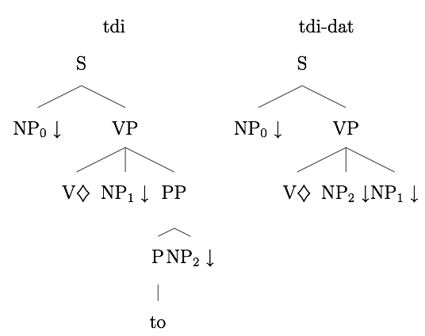
Adding language features to neural LMs
z_{t-5}
z_{t-4}
z_{t-3}
z_{t-2}
z_{t-1}
Additional features
can be added as inputs
to the neural net / linear
prediction function.
We tried POS
(part-of-speech tags)
and super-tags derived
from incomplete parsing.
word embedding space ℜ^{D}
feature embedding space ℜ^{F}
A
h
B
ẑ_{t}
z_{t}
C
E
feature
embedding
F
F
F
F
F
word
embedding
R
R
R
R
R
R
discrete POS
features {0,1}^{P}
the
cat
sat
on
the
DT
NN
VBD
IN
DT
DT
NN
VBD
IN
DT
discrete word space {1, ..., V}
wt-5
wt-4
wt-3
wt-2
wt-1
wt
the
cat
sat
on
the
mat

Slide 38
Constraining word representations
word embedding space ℜ^{D}
z_{t-5}
z_{t-4}
z_{t-3}
z_{t-2}
z_{t-1}
Using the WordNet hierarchical
similarity between words,
we tried to force some words
to remain similar to a small
set of WordNet neighbours.
feature embedding space ℜ^{F}
A
h
B
ẑ_{t}
z_{t}
C
E
feature
embedding
F
F
F
F
F
word
embedding
R
R
R
R
R
R
discrete POS
features {0,1}^{P}
WordNet graph of words
No significant change in
training time or language
model performance.
DT
NN
VBD
IN
DT
discrete word space {1, ..., V}
wt-5
wt-4
wt-3
wt-2
wt-1
wt
the
cat
sat
on
the
mat

Slide 39
Topic mixtures of language models
h⁽¹⁾
We pre-computed the
unsupervised topic
model representation of
each sentence in training
using LDA (Latent Dirichlet
Allocation) [Blei et al, 2003]
with 5 topics.
On test data, estimate topic using
trained LDA model.
word embedding space ℜ^{D}
z_{t-5}
z_{t-4}
z_{t-3}
z_{t-2}
z_{t-1}
A⁽¹⁾
B⁽¹⁾
θ1
A^{(k)}
h^{(k)}
B^{(k)}
feature embedding space ℜ^{F}
θk
ẑ_{t}
z_{t}
C⁽¹⁾
θ1
E
feature
embedding
F
F
F
F
F
θk
C^{(k)}
word
embedding
R
R
R
R
R
R
discrete POS
features {0,1}^{P}
DT
NN
VBD
IN
DT
Enables to model
long-range
dependencies at sentence level.
discrete word space {1, ..., V}
sentence or
document
topic
(5 topics)
f
wt-5
wt-4
wt-3
wt-2
wt-1
wt
the
cat
sat
on
the
mat
[Mirowski, Chopra, Balakrishnan and Bangalore (2010)
“Feature-rich continuous language models for speech recognition”, SLT;
David Blei (2003) "Latent Dirichlet Allocation", JMLR]

Slide 40
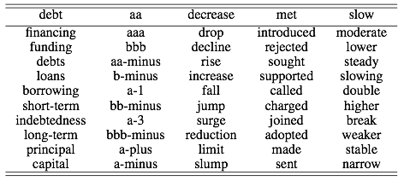
Word embeddings obtained on Reuters
Example of word embeddings obtained using our language model on the Reuters corpus
(1.5 million words, vocabulary V=12k words), vector space of dimension D=100
For each word, the 10 nearest neighbours in the vector space retrieved using cosine similarity:
[Mirowski, Chopra, Balakrishnan and Bangalore (2010)
“Feature-rich continuous language models for speech recognition”, SLT]

Slide 41
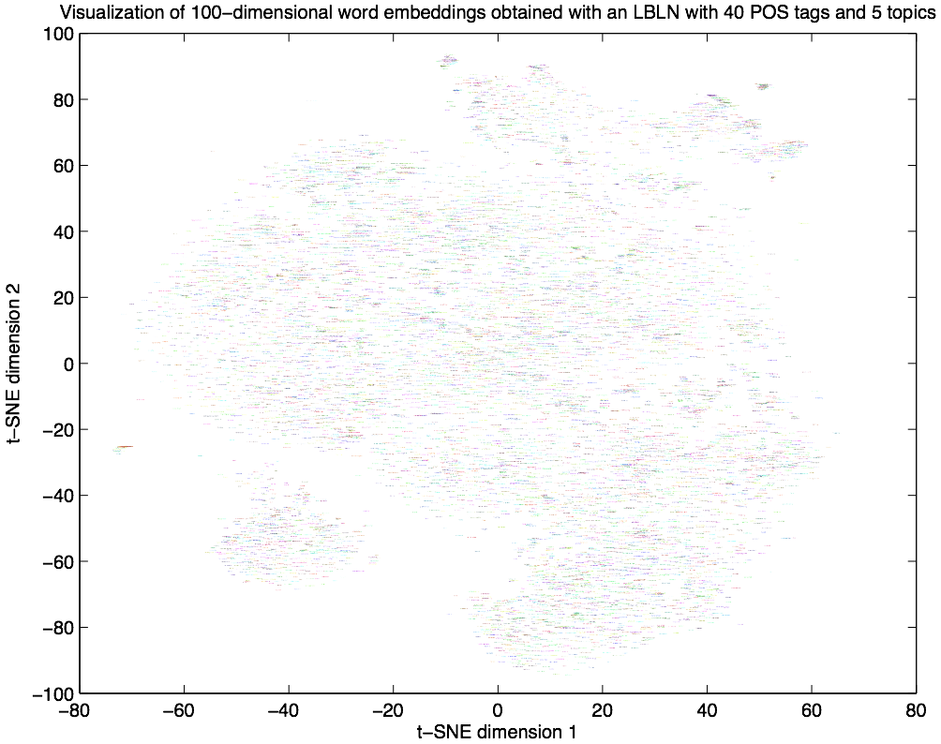

Word embeddings obtained on AP News
Example of word embeddings obtained using our LM on AP News
(14M words, V=17k), D=100
The word embedding matrix R was projected in 2D by Stochastic t-SNE
[Van der Maaten, JMLR 2008]
[Mirowski (2010)
“Time series modelling with hidden variables and gradient-based algorithms”, NYU PhD thesis]

Slide 42
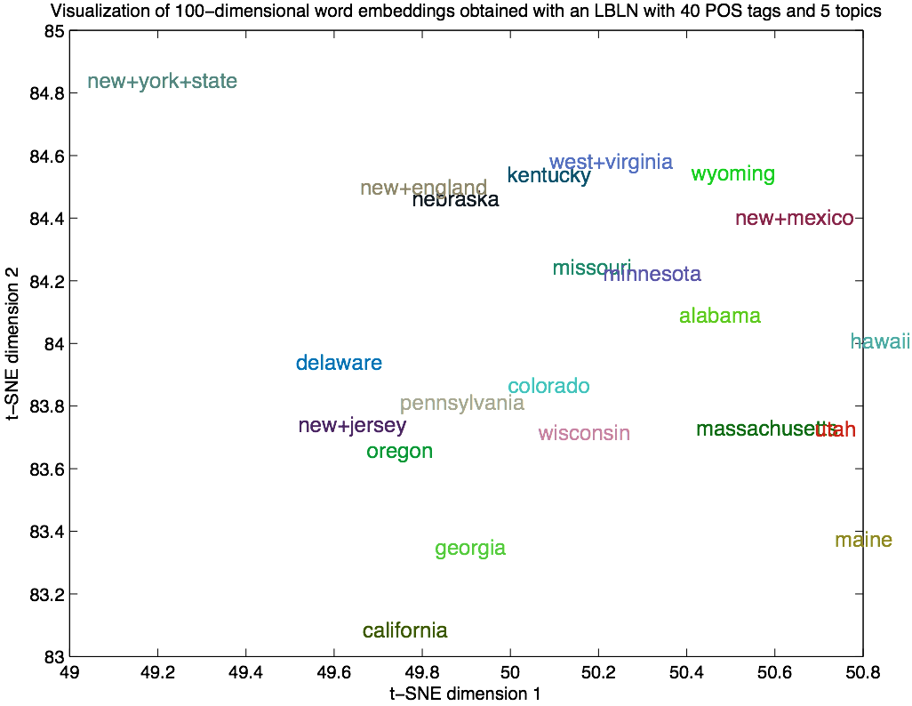
Word embeddings obtained on AP News
Example of word embeddings obtained using our LM on AP News
(14M words, V=17k), D=100
The word embedding matrix R was projected in 2D by Stochastic t-SNE
[Van der Maaten, JMLR 2008]
[Mirowski (2010)
“Time series modelling with hidden variables and gradient-based algorithms”, NYU PhD thesis]

Slide 43
Word embeddings obtained on AP News
Example of word embeddings obtained using our LM on AP News
(14M words, V=17k), D=100
The word embedding matrix R was projected in 2D by Stochastic t-SNE
[Van der Maaten, JMLR 2008]
[Mirowski (2010)
“Time series modelling with hidden variables and gradient-based algorithms”, NYU PhD thesis]

Slide 44
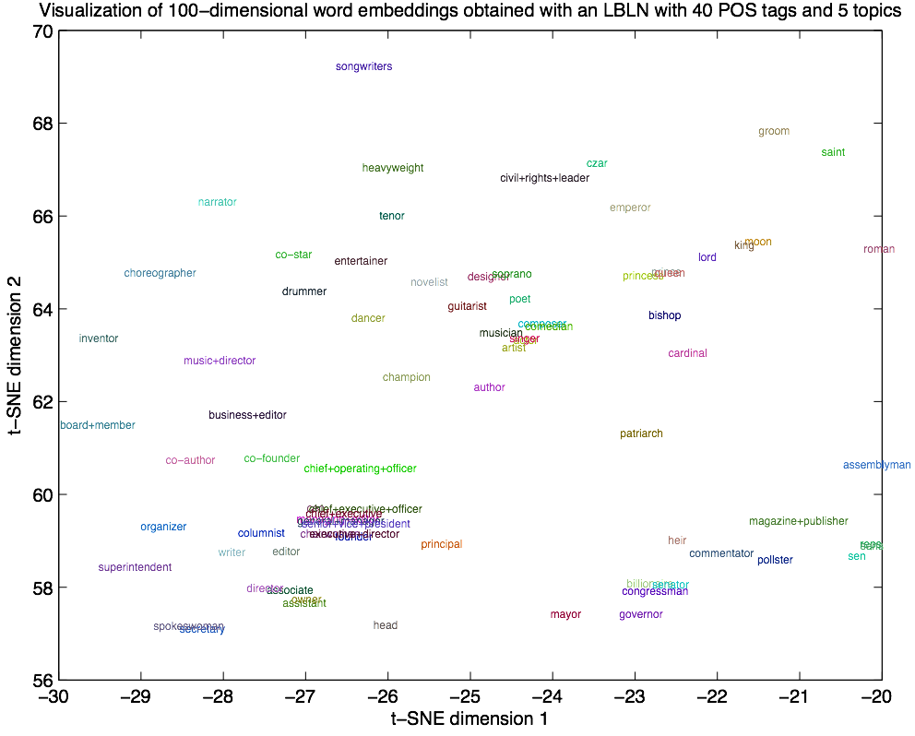
Word embeddings obtained on AP News
Example of word embeddings obtained using our LM on AP News
(14M words, V=17k), D=100
The word embedding matrix R was projected in 2D by Stochastic t-SNE
[Van der Maaten, JMLR 2008]
[Mirowski (2010)
“Time series modelling with hidden variables and gradient-based algorithms”, NYU PhD thesis]

Slide 45

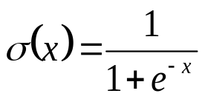

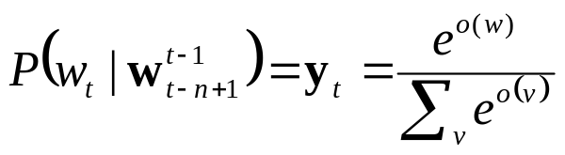
Recurrent Neural Net (RNN) language model
Time-delay
1-layer
neural network
with D output units
word embedding
space ℜ^{D}
in dimension
D=30 to 250
z_{t-1}
z_{t}
W
h
Word embedding matrix
U
V
o
discrete word space {1, ..., M}
M>100k words
Handles longer word history
(~10 words) as well
as 10-gram feed-forward NNLM
Training algorithm: BPTT
Back-Propagation Through Time
wt-5
wt-4
wt-3
wt-2
wt-1
wt
the
cat
sat
on
the
mat
Complexity: D×D + D×D + D×V
[Mikolov et al, 2010, 2011]

Slide 46


Context-dependent RNN language model
Time-delay
1-layer
neural network
with D output units
word embedding
space ℜ^{D}
in dimension D=200
z_{t-1}
h
z_{t}
W
F
sentence or
document
topic
(K=40 topics)
U
V
f
G
o
discrete word space {1, ..., M}
M>100k words
Compute topic
model representation
word-by-word on last 50 words
using approximate LDA
[Blei et al, 2003]
with K topics.
Enables to model long-range
dependencies at sentence level.
wt-5
wt-4
wt-3
wt-2
wt-1
wt
the
cat
sat
on
the
mat
[Mikolov & Zweig, 2012]

Slide 47
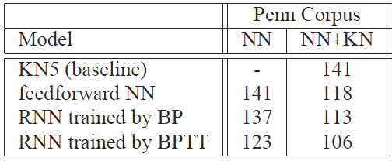
Perplexity of RNN language models
Model | Test ppx
Kneyser-Ney back-off 5-grams | 123.3
Nonlinear LBL (100d) [Mnih & Hinton, 2009, using our implementation] | 104.4
NLBL (100d) + 5 topics LDA [Mirowski, 2010, using our implementation] | 98.5
RNN (200d) + 40 topics LDA [Mikolov & Zweig, 2012, using RNN toolbox] | 86.9
Penn TreeBank
V=10k vocabulary
Train on 900k words
Validate on 80k words
Test on 80k words
AP News
V=17k vocabulary
Train on 14M words
Validate on 1M words
Test on 1M words
[Mirowski, 2010; Mikolov & Zweig, 2012;
RNN toolbox: http://research.microsoft.com/en-us/projects/rnn/default.aspx]

Slide 48
Outline
Probabilistic Language Models (LMs)
  Likelihood of a sentence and LM perplexity
  Limitations of n-grams
Neural Probabilistic LMs
  Vector-space representation of words
  Neural probabilistic language model
  Log-Bilinear (LBL) LMs
Long-range dependencies
  Enhancing LBL with linguistic features
  Recurrent Neural Networks (RNN)
Applications
  Speech recognition and machine translation
  Sentence completion and linguistic regularities
Bag-of-word-vector approaches
  Auto-encoders for text
  Continuous bag-of-words and skip-gram models
Scalability with large vocabularies
  Tree-structured LMs
  Noise-contrastive estimation

Slide 49
Performance of LBL on speech recognition
HUB-4 TV broadcast transcripts
Vocabulary V=25k
(with proper nouns & numbers)
#topics | POS | Word accuracy | Method
- | - | 63.7% | AT&T Watson [Goffin et al, 2005]
- | - | 63.5% | KN 5-grams on 100-best list
- | - | 66.6% | Oracle: best of 100-best list
- | - | 57.8% | Oracle: worst of 100-best list
0 | - | 64.1% | Log-Bilinear models with nonlinearity and optional POS tag inputs and LDA topic model mixtures
0 | F=34 | 64.1%
0 | F=3 | 64.1%
5 | - | 64.2%
5 | F=34 | 64.6%
5 | F=3 | 64.6%
Train on 1M words
Validate on 50k words
Test on 800 sentences
Re-rank top 100
candidate sentences, provided for each spoken sentence
by a speech recognition
system (acoustic model + simple trigram)
[Mirowski et al, 2010]

Slide 50
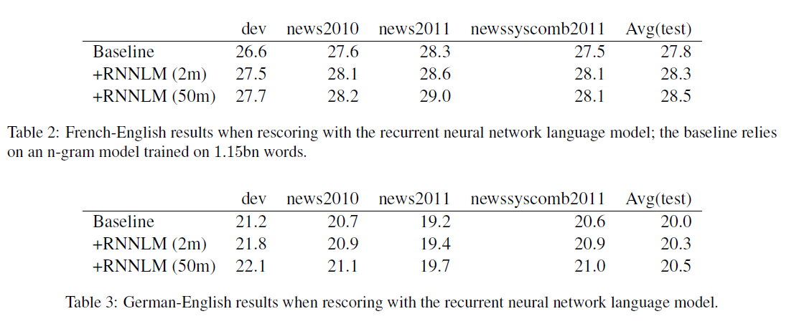
Performance of RNN on machine translation
RNN with 100 hidden nodes
Trained using 20-step BPTT
Uses lattice rescoring
RNN trained on 2M words already improves over n-gram trained on 1.15B words
[Auli et al, 2013]

Slide 51
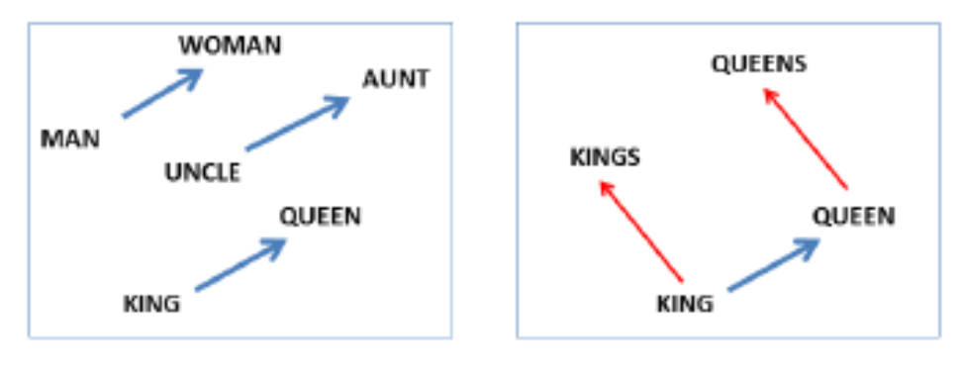
Syntactic and Semantic tests with RNN
Observed that word embeddings obtained by RNN-LDA
have linguistic regularities “a” is to “b” as “c” is to _
Syntactic: king is to kings as queen is to queens
Semantic: clothing is to shirt as dish is to bowl
Vector offset method
Z₁
-
Z₂
+
Z₃
=
ẑ
Z_{v}
cosine
similarity
[Image credits: Mikolov et al (2013) “Efficient Estimation of Word Representation in Vector Space”, arXiv]

Slide 52
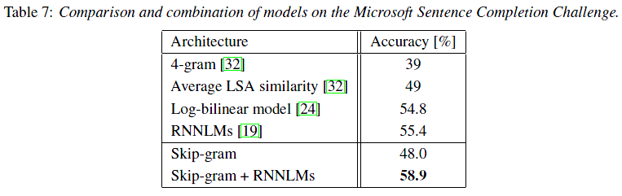
Microsoft Research Sentence Completion Task
1040 sentences with missing word;
5 choices for each missing word.
Language model trained on 500 novels
(Project Gutenberg)
provided 30 alternative words
for each missing word;
Judges selected top 4 impostor words.
Human performance: 90% accuracy
All red-headed men who are above the age of [ 800 | seven | twenty-one | 1,200 | 60,000] years, are eligible.
That is his [ generous | mother’s | successful | favorite | main ] fault, but on the whole he’s a good worker.
[Zweig & Burges, 2011; Mikolov et al, 2013a;
http://research.microsoft.com/apps/pubs/default.aspx?id=157031 ]

Slide 53
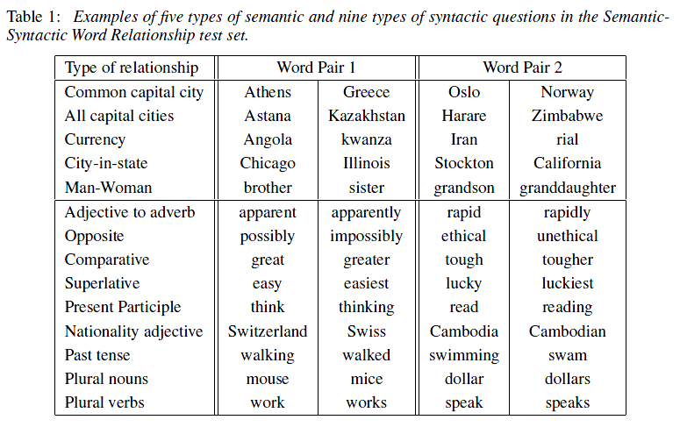
Semantic-syntactic word evaluation task
[Mikolov et al, 2013a, 2013b; http://code.google.com/p/word2vec]

Slide 54
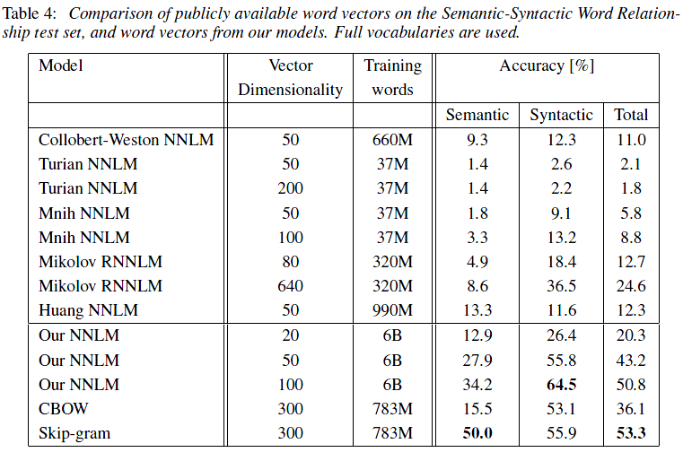
Semantic-syntactic word evaluation task
[Mikolov et al, 2013a, 2013b; http://code.google.com/p/word2vec]

Slide 55
Outline
Probabilistic Language Models (LMs)
  Likelihood of a sentence and LM perplexity
  Limitations of n-grams
Neural Probabilistic LMs
  Vector-space representation of words
  Neural probabilistic language model
  Log-Bilinear (LBL) LMs
Long-range dependencies
  Enhancing LBL with linguistic features
  Recurrent Neural Networks (RNN)
Applications
  Speech recognition and machine translation
  Sentence completion and linguistic regularities
Bag-of-word-vector approaches
  Auto-encoders for text
  Continuous bag-of-words and skip-gram models
Scalability with large vocabularies
  Tree-structured LMs
  Noise-contrastive estimation

Slide 56
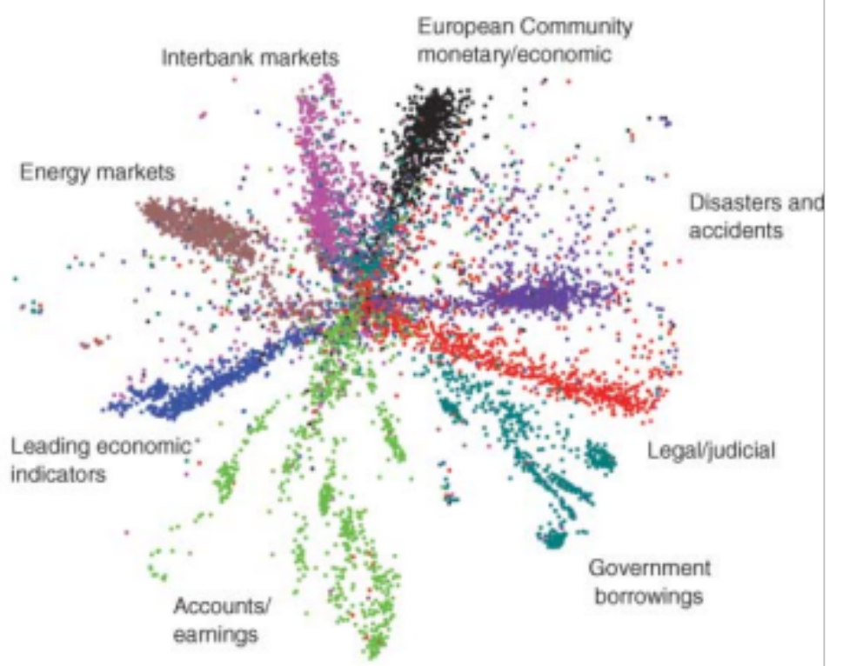
Semantic Hashing
2000
500
250
125
2
125
250
500
2000
[Hinton & Salakhutdinov, “Reducing the dimensionality of data with neural networks, Science, 2006;
Salakhutdinov & Hinton, “Semantic Hashing”, Int J Approx Reason, 2007]

Slide 57
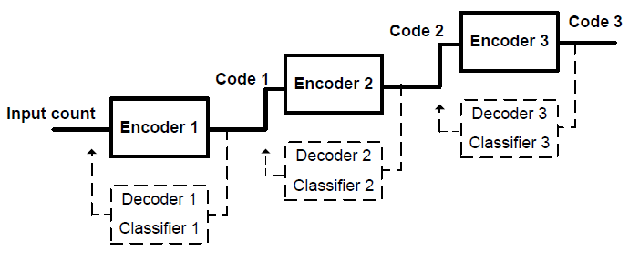
Semi-supervised learning of auto-encoders
Add classifier module to the codes
When a input X(t) has a label Y(t),
back-propagate the prediction error on Y(t)
to the code Z(t)
Stack the encoders
Train layer-wise
y(t)
y(t+1)
document
classifier f3
z⁽³⁾(t)
z⁽³⁾(t+1)
y(t)
y(t+1)
auto-encoder g3,h3
document
classifier f2
z⁽²⁾(t)
z⁽²⁾(t+1)
y(t)
y(t+1)
auto-encoder g2,h2
document
classifier f1
z⁽¹⁾(t)
z⁽¹⁾(t+1)
Random
walk
auto-encoder g1,h1
word histograms
x(t)
x(t+1)
[Ranzato & Szummer, “Semi-supervised learning of compact document representations with deep networks”, ICML, 2008;
Mirowski, Ranzato & LeCun, “Dynamic auto-encoders for semantic indexing”, NIPS Deep Learning Workshop, 2010]

Slide 58
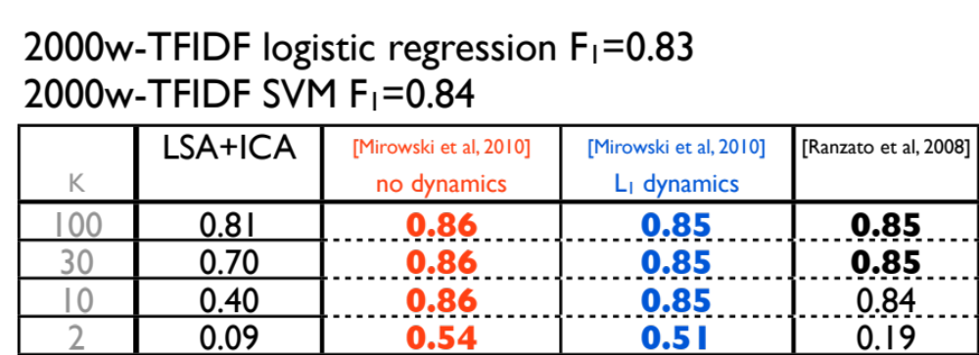
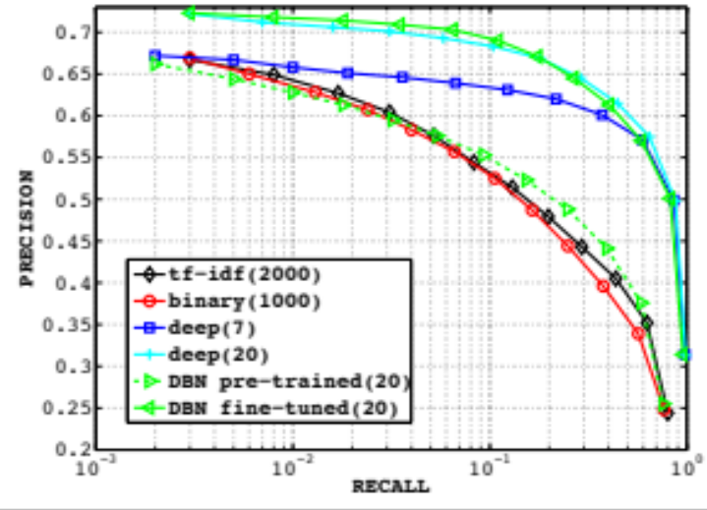
Semi-supervised learning of auto-encoders
Performance on document retrieval task:
Reuters-21k dataset (9.6k training, 4k test),
vocabulary 2k words, 10-class classification
Comparison with:
unsupervised techniques
(DBN: Semantic Hashing, LSA) + SVM
traditional technique: word TF-IDF + SVM
[Ranzato & Szummer, “Semi-supervised learning of compact document representations with deep networks”, ICML, 2008;
Mirowski, Ranzato & LeCun, “Dynamic auto-encoders for semantic indexing”, NIPS Deep Learning Workshop, 2010]

Slide 59
Deep Structured Semantic Models for web search
Compute Cosine similarity
between semantic vectors
cos(s,t1)
cos(s,t2)
Semantic vector
d=300
d=300
d=300
W₄
d=500
d=500
d=500
W₃
Letter-tri-gram embedding matrix
d=500
d=500
d=500
W₂
Letter-tri-gram coeff.
matrix (fixed)
dim = 50K
dim = 50K
dim = 50K
W₁
Bag-of-words vector
dim = 5M
dim = 5M
dim = 5M
Input word/phrase
s: “racing car”
t1: “formula one”
t2: “ford model t”
[Huang, He, Gao, Deng et al, “Learning Deep Structured Semantic Models for Web Search using Clickthrough Data”, CIKM, 2013]

Slide 60
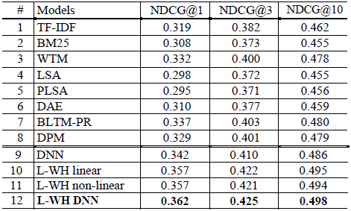
Deep Structured Semantic Models for web search
Results on a web ranking task (16k queries)
Normalized discounted cumulative gains
Semantic hashing
[Salakhutdinov & Hinton, 2007]
Deep Structured
Semantic Model
[Huang, He, Gao et al, 2013]
[Huang, He, Gao, Deng et al, “Learning Deep Structured Semantic Models for Web Search using Clickthrough Data”, CIKM, 2013]

Slide 61
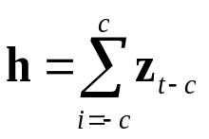

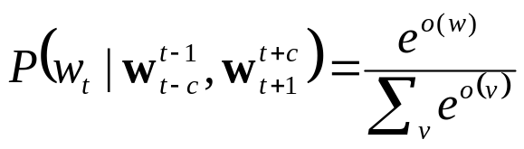
Continuous Bag-of-Words
Simple sum
word embedding
space ℜ^{D}
in dimension
D=100 to 300
h
Word embedding matrices
U
U
U
U
W
Extremely efficient estimation of
word embeddings in matrix U
without a Language Model.
Can be used as input to neural LM.
Enables much larger datasets, e.g.,
Google News (6B words, V=1M)
discrete word space {1, ..., V}
V>100k words
wt-2
wt-1
wt+1
wt+2
wt
the
cat
on
the
sat
Complexity: 2C×D + D×V
Complexity: 2C×D + D×log(V) (hierarchical softmax using tree factorization)
[Mikolov et al, 2013a; Mnih & Kavukcuoglu, 2013;
http://code.google.com/p/word2vec ]

Slide 62


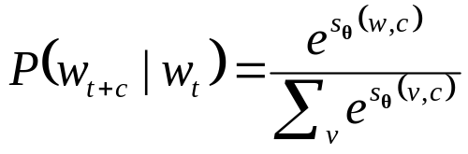
Skip-gram
word embedding
space ℜ^{D}
in dimension
D=100 to 1000
zt
Word embedding matrices
W
W
W
W
U
Extremely efficient estimation of
word embeddings in matrix U
without a Language Model.
Can be used as input to neural LM.
Enables much larger datasets, e.g.,
Google News (33B words, V=1M)
discrete word space {1, ..., V}
V>100k words
wt-2
wt-1
wt+1
wt+2
wt
the
cat
on
the
sat
Complexity: 2C×D + 2C×D×V
Complexity: 2C×D + 2C×D×log(V) (hierarchical softmax using tree factorization)
Complexity: 2C×D + 2C×D×(k+1) (negative sampling with k negative examples)
[Mikolov et al, 2013a, 2013b; Mnih & Kavukcuoglu, 2013;
http://code.google.com/p/word2vec ]

Slide 63
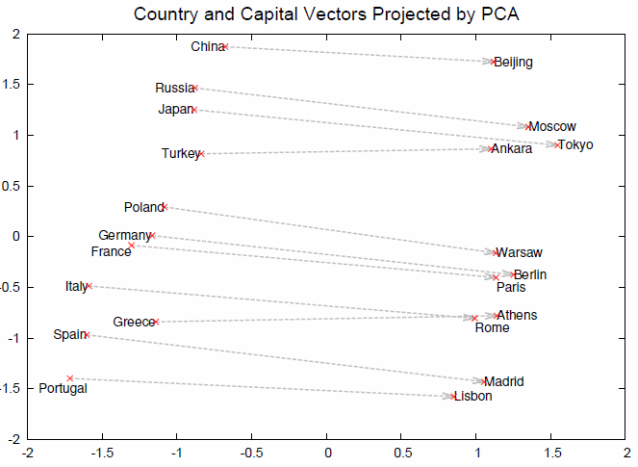
Vector-space word representation without LM
Word and phrase representation
learned by skip-gram
exhibit linear structure that enables analogies with vector arithmetics.
This is due to training objective,
input and output (before softmax)
are in linear relationship.
The sum of vectors in the loss function
is the sum of log-probabilities
(or log of product of probabilities),
i.e., comparable to the AND function.
[Image credits: Mikolov et al (2013) “Distributed Representations of Words and Phrases and their Compositionality”, NIPS]
[Mikolov et al, 2013a, 2013b; http://code.google.com/p/word2vec]

Slide 64
Examples of Word2Vec embeddings
debt | aa | decrease | met | slow | france | jesus | xbox
debts | aaarm | increase | meeting | slower | marseille | christ | playstation
repayments | samavat | increases | meet | fast | french | resurrection | wii
repayment | obukhovskii | decreased | meets | slowing | nantes | savior | xbla
monetary | emerlec | greatly | had | slows | vichy | miscl | wiiware
payments | gunss | decreasing | welcomed | slowed | paris | crucified | gamecube
repay | dekhen | increased | insisted | faster | bordeaux | god | nintendo
mortgage | minizini | decreases | acquainted | sluggish | aubagne | apostles | kinect
repaid | bf | reduces | satisfied | quicker | vend | apostle | dsiware
refinancing | mortardepth | reduce | first | pace | vienne | bickertonite | eshop
bailouts | ee | increasing | persuaded | slowly | toulouse | pretribulational | dreamcast
Example of word embeddings obtained using Word2Vec on the 3.2B word Wikipedia:
Vocabulary V=2M
Continuous vector space D=200
Trained using CBOW
[Mikolov et al, 2013a, 2013b; http://code.google.com/p/word2vec]

Slide 65
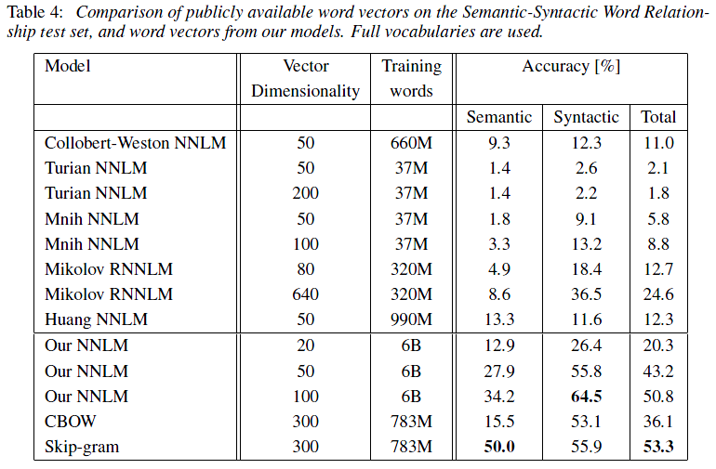
Performance on the semantic-syntactic task
[Image credits: Mikolov et al (2013) “Distributed Representations of Words and Phrases and their Compositionality”, NIPS]
Word and phrase representation learned by skip-gram
exhibit linear structure that enables analogies with vector arithmetics.
Due to training objective, input and output (before softmax) in linear relationship.
Sum of vectors is like sum of log-probabilities, i.e. log of product of probabilities,
i.e., AND function.
[Mikolov et al, 2013a, 2013b; http://code.google.com/p/word2vec]

Slide 66
Outline
Probabilistic Language Models (LMs)
  Likelihood of a sentence and LM perplexity
  Limitations of n-grams
Neural Probabilistic LMs
  Vector-space representation of words
  Neural probabilistic language model
  Log-Bilinear (LBL) LMs
Long-range dependencies
  Enhancing LBL with linguistic features
  Recurrent Neural Networks (RNN)
Applications
  Speech recognition and machine translation
  Sentence completion and linguistic regularities
Bag-of-word-vector approaches
  Auto-encoders for text
  Continuous bag-of-words and skip-gram models
Scalability with large vocabularies
  Tree-structured LMs
  Noise-contrastive estimation

Slide 67



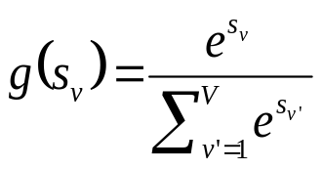

Computational bottleneck of large vocabularies
target word
Bulk of computation at
word prediction
and at input word embedding layers
Large vocabularies:
  AP News (14M words; V=17k)
  HUB-4 (1M words; V=25k)
  Google News (6B words, V=1M)
  Wikipedia (3.2B, V=2M)
Strategies to compress output softmax
word history
scoring function
softmax

Slide 68
Reducing the bottleneck of large vocabularies
Replace rare words, numbers by <unk> token
Subsample frequent words during training
  Speed-up 2x to 10x
  Better accuracy for rare words
Hierarchical Softmax (HS)
Noise-Contrastive Estimation (NCE) and
Negative Sampling (NS)

Slide 69

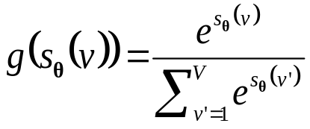



Hierarchical softmax by grouping words
target word
Group words
into disjoint classes:
  E.g., 20 classes
  with frequency binning
  Use unigram frequency
  Top 5% words (“the”) go to class 1
  Following 5% words go to class 2
Factorize word probability into:
  Class probability
  Class-conditional
  word probability
Speed-up factor:
  O(|V|) to O(|C|+max|VC|)
word history
scoring function
softmax
[Mikolov et al, 2011, Auli et al, 2013]

Slide 70
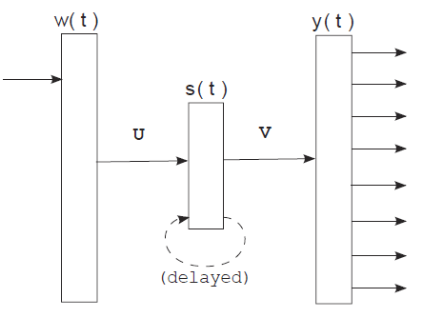
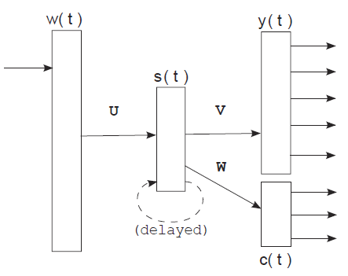
Hierarchical softmax by grouping words
target word
word history
scoring function
softmax
[Mikolov et al, 2011, Auli et al, 2013]

Slide 71
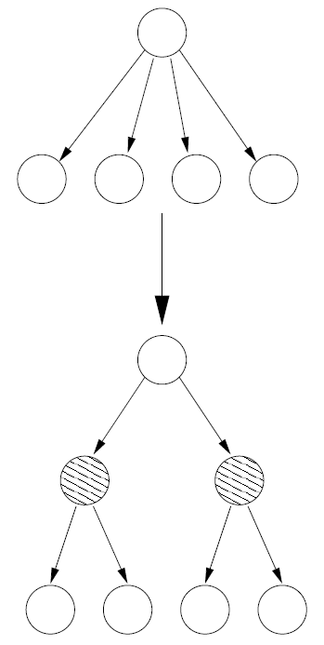
Hierarchical softmax using WordNet
Use WordNet to extract IS-A relationships
  Manually select
  one parent per child
  In the case of multiple children,
  cluster them to obtain
  a binary tree
Hard to design
Hard to adapt
to other languages
[Morin & Bengio, 2005; http://wordnet.princeton.edu]

Slide 72

Hierarchical softmax using Huffman trees
Frequency-based binning
“this is an example of a huffman tree”
[Mikolov et al, 2013a, 2013b]

Slide 73










Hierarchical softmax using Huffman trees
target word
Replace comparison with V vectors
of target words
by comparison with log(V) vectors
word history
path to
target word
at node j
predicted word
vector
vector at node j
of target word
sigmoid
[Mikolov et al, 2013a, 2013b]

Slide 74



Noise-Contrastive Estimation
Conditional probability of word w in the data:
Conditional probability that word w comes
from data D and not from the noise distribution:
  Auxiliary binary classification problem:
    Positive examples (data) vs. negative examples (noise)
  Scaling factor k: noisy samples k times more likely than data samples
    Noise distribution: based on unigram word probabilities
  Empirically, model can cope with un-normalized probabilities:
[Mnih & Teh, 2012; Mnih & Kavukcuoglu, 2013; Mikolov et al, 2013a, 2013b]

Slide 75


Noise-Contrastive Estimation
Conditional probability that word w comes
from data D and not from the noise distribution:
  Auxiliary binary classification problem:
    Positive examples (data) vs. negative examples (noise)
  Scaling factor k: noisy samples k times more likely than data samples
    Noise distribution: based on unigram word probabilities
  Introduce log of difference between:
    score of word w under data distribution
    and unigram distribution score of word w
[Mnih & Teh, 2012; Mnih & Kavukcuoglu, 2013; Mikolov et al, 2013a, 2013b]

Slide 76

Noise-Contrastive Estimation
New loss function to maximize:
Compare to Maximum Likelihood learning:
[Mnih & Teh, 2012; Mnih & Kavukcuoglu, 2013; Mikolov et al, 2013a, 2013b]

Slide 77



Negative sampling
Noise contrastive estimation
Negative sampling
  Remove normalization term in probabilities
Compare to Maximum Likelihood learning:
[Mnih & Teh, 2012; Mnih & Kavukcuoglu, 2013; Mikolov et al, 2013a, 2013b]

Slide 78


Speed-up over full softmax
LBL with full softmax,
trained on APNews data,
14M words, V=17k
7days
Skip-gram (context 5)
with phrases, trained
using negative sampling,
on Google data,
33G words, V=692k + phrases
1 day
Penn
TreeBank
data
(900k words,
V=10k)
LBL (2-gram, 100d)
with full softmax, 1 day
LBL (2-gram, 100d) with
noise contrastive estimation
1.5 hours
RNN (HS) | 50 classes | 145.4 | 0.5
RNN (100d) with
50-class hierarchical softmax
0.5 hours (own experience)
[Image credits: Mnih & Teh (2012) “A fast and simple algorithm for training neura probabilistic language models”, ICML]
[Mnih & Teh, 2012; Mikolov et al, 2010-2012, 2013b]

Slide 79
Thank you!
Further references: following this slide
Basic (N)LBL Matlab code available on demand
Contact:
piotr.mirowski@computer.org
Acknowledgements:
Sumit Chopra (AT&T Labs Research / Facebook)
Srinivas Bangalore (AT&T Labs Research)
Suhrid Balakrishnan (AT&T Labs Research)
Yann LeCun (NYU / Facebook)
Abhishek Arun (Microsoft Bing)

Slide 80
References
Basic n-grams with smoothing and backtracking (no word vector representation):
  S. Katz, (1987)
  "Estimation of probabilities from sparse data for the language model component of a speech recognizer",
  IEEE Transactions on Acoustics, Speech and Signal Processing,
  vol. ASSP-35, no. 3, pp. 400–401
  https://www.mscs.mu.edu/~cstruble/moodle/file.php/3/papers/01165125.pdf
  S. F. Chen and J. Goodman (1996)
  "An empirical study of smoothing techniques for language modelling",
  ACL
  http://acl.ldc.upenn.edu/P/P96/P96-1041.pdf?origin=publication_detail
  A. Stolcke (2002)
  "SRILM - an extensible language modeling toolkit”
  ICSLP, pp. 901–904
  http://my.fit.edu/~vkepuska/ece5527/Projects/Fall2011/Sundaresan,%20Venkata%20Subramanyan/srilm/doc/paper.pdf

Slide 81
References
Neural network language models:
  Y. Bengio, R. Ducharme, P. Vincent and J.-L. Jauvin (2001, 2003)
  "A Neural Probabilistic Language Model",
  NIPS (2000) 13:933-938
  J. Machine Learning Research (2003) 3:1137-115
  http://www.iro.umontreal.ca/~lisa/pointeurs/BengioDucharmeVincentJauvin_jmlr.pdf
  F. Morin and Y. Bengio (2005)
  “Hierarchical probabilistic neural network language model",
  AISTATS
  http://core.kmi.open.ac.uk/download/pdf/22017.pdf#page=255
  Y. Bengio, H. Schwenk, J.-S. Senécal, F. Morin, J.-L. Gauvain (2006)
  "Neural Probabilistic Language Models",
  Innovations in Machine Learning, vol. 194, pp 137-186
  http://rd.springer.com/chapter/10.1007/3-540-33486-6_6

Slide 82
References
Linear and/or nonlinear (neural network-based) language models:
  A. Mnih and G. Hinton (2007)
  "Three new graphical models for statistical language modelling",
  ICML, pp. 641–648, http://www.cs.utoronto.ca/~hinton/absps/threenew.pdf
  A. Mnih, Y. Zhang, and G. Hinton (2009)
  "Improving a statistical language model through non-linear prediction",
  Neurocomputing, vol. 72, no. 7-9, pp. 1414 – 1418
  http://www.sciencedirect.com/science/article/pii/S0925231209000083
  A. Mnih and Y.-W. Teh (2012)
  "A fast and simple algorithm for training neural probabilistic language models“
  ICML, http://arxiv.org/pdf/1206.6426
  A. Mnih and K. Kavukcuoglu (2013)
  “Learning word embeddings efficiently with noise-contrastive estimation“
  NIPS
  http://papers.nips.cc/paper/5165-learning-word-embeddings-efficiently-with-noise-contrastive-estimation.pdf

Slide 83
References
Recurrent neural networks
(long-term memory of word context):
  Tomas Mikolov, M Karafiat, J Cernocky, S Khudanpur (2010)
  "Recurrent neural network-based language model“
  Interspeech
  T. Mikolov, S. Kombrink, L. Burger, J. Cernocky and S. Khudanpur (2011)
  “Extensions of Recurrent Neural Network Language Model“
  ICASSP
  Tomas Mikolov and Geoff Zweig (2012)
  "Context-dependent Recurrent Neural Network Language Model“
  IEEE Speech Language Technologies
  Tomas Mikolov, Wen-Tau Yih and Geoffrey Zweig (2013)
  "Linguistic Regularities in Continuous SpaceWord Representations"
  NAACL-HLT
  https://www.aclweb.org/anthology/N/N13/N13-1090.pdf
  http://research.microsoft.com/en-us/projects/rnn/default.aspx

Slide 84
References
Applications:
  P. Mirowski, S. Chopra, S. Balakrishnan and S. Bangalore (2010)
  “Feature-rich continuous language models for speech recognition”,
  SLT
  G. Zweig and C. Burges (2011)
  “The Microsoft Research Sentence Completion Challenge”
  MSR Technical Report MSR-TR-2011-129
  http://research.microsoft.com/apps/pubs/default.aspx?id=157031
  M. Auli, M. Galley, C. Quirk and G. Zweig (2013)
  “Joint Language and Translation Modeling with Recurrent Neural Networks”
  EMNLP
  K. Yao, G. Zweig, M.-Y. Hwang, Y. Shi and D. Yu (2013)
  “Recurrent Neural Networks for Language Understanding”
  Interspeech

Slide 85
References
Continuous Bags of Words, Skip-Grams, Word2Vec:
  Tomas Mikolov et al (2013)
  “Efficient Estimation of Word Representation in Vector Space“
  arXiv.1301.3781v3
  Tomas Mikolov et al (2013)
  “Distributed Representation of Words and Phrases and their Compositionality”
  arXiv.1310.4546v1, NIPS
  http://code.google.com/p/word2vec

Slide 87
Probabilistic
Language Models
Goal:
score sentences according to their likelihood
  Machine Translation:
    P(high winds tonight) > P(large winds tonight)
  Spell Correction
    The office is about fifteen minuets from my house
    P(about fifteen minutes from) > P(about fifteen minuets from)
  Speech Recognition
    P(I saw a van) >> P(eyes awe of an)
    Re-ranking n-best lists of sentences produced by an acoustic model,
    taking the best
Secondary goal:
sentence completion or generation

Slide 88

Example of a bigram language model
Training data
Model
Test data
There is a big house
I buy a house
They buy the new house
p(big|a) = 0.5
p(is|there) = 1
p(buy|they) = 1
p(house|a) = 0.5
p(buy|i) = 1
p(a|buy) = 0.5
p(new|the) = 1
p(house|big) = 1
p(the|buy) = 0.5
p(a| is) = 1
p(house|new) = 1
p(they| < s >) = .333
S1:
they buy a big house
P(S1) = 0.333 * 1 * 0.5 * 0.5 * 1
P(S1) = 0.0833
S2:
they buy a new house
P(S2) = ?

Slide 89
Intuitive view of perplexity
How well can we predict next word?
  A random predictor would give each word probability 1/V
  where V is the size of the vocabulary
  A better model of a text should assign a higher probability
  to the word that actually occurs
Perplexity:
  “how many words are likely to happen, given the context”
  Perplexity of 1 means that the model recites the text by heart
  Perplexity of V means that the model produces uniform random guesses
  The lower the perplexity, the better the language model
mushrooms 0.1
pepperoni 0.1
anchovies 0.01
….
fried rice 0.0001
….
and 1e-100
I always order pizza with cheese and ____
The 33rd President of the US was ____
I saw a ____

Slide 90

Stochastic gradient descent
[LeCun et al, "Efficient BackProp", Neural Networks: Tricks of the Trade, 1998;
Bottou, "Stochastic Learning", Slides from a talk in Tubingen, 2003]

Slide 91

Stochastic gradient descent
[LeCun et al, "Efficient BackProp", Neural Networks: Tricks of the Trade, 1998;
Bottou, "Stochastic Learning", Slides from a talk in Tubingen, 2003]

Slide 92









Dimensionality reduction and invariant mapping
Similarly
labelled
samples
Dissimilar
codes
[Hadsell, Chopra & LeCun, “Dimensionality Reduction by Learning an Invariant Mapping”, CVPR, 2006]

Slide 93



Auto-encoder
Target
= input
Target
= input
Code
Code
Input
Input
“Bottleneck” code
i.e., low-dimensional,
typically dense,
distributed
representation
“Overcomplete” code
i.e., high-dimensional,
always sparse,
distributed
representation

Slide 94




Auto-encoder
Code
Encoding
“energy”
Input
decoding
Code
prediction
Decoding
“energy”
Input

Slide 95


Auto-encoder
Code
Encoding
energy
Input
decoding
Code
prediction
Decoding
energy
Input

Slide 96

Auto-encoder loss function
For one sample t
Encoding energy
Decoding energy
coefficient of
the encoder error
For all T samples
Encoding energy
Decoding energy
How do we get the codes Z?
We note W={C, b_{C}, D, b_{D}}

Slide 97




Auto-encoder backprop w.r.t. codes
Code
Encoding
energy
Code
prediction
Input
[Ranzato, Boureau & LeCun, “Sparse Feature Learning for Deep Belief Networks ”, NIPS, 2007]

Slide 98







Auto-encoder backprop w.r.t. codes
Code
Encoding
energy
Code
prediction
Input
[Ranzato, Boureau & LeCun, “Sparse Feature Learning for Deep Belief Networks ”, NIPS, 2007]

